Slide 1
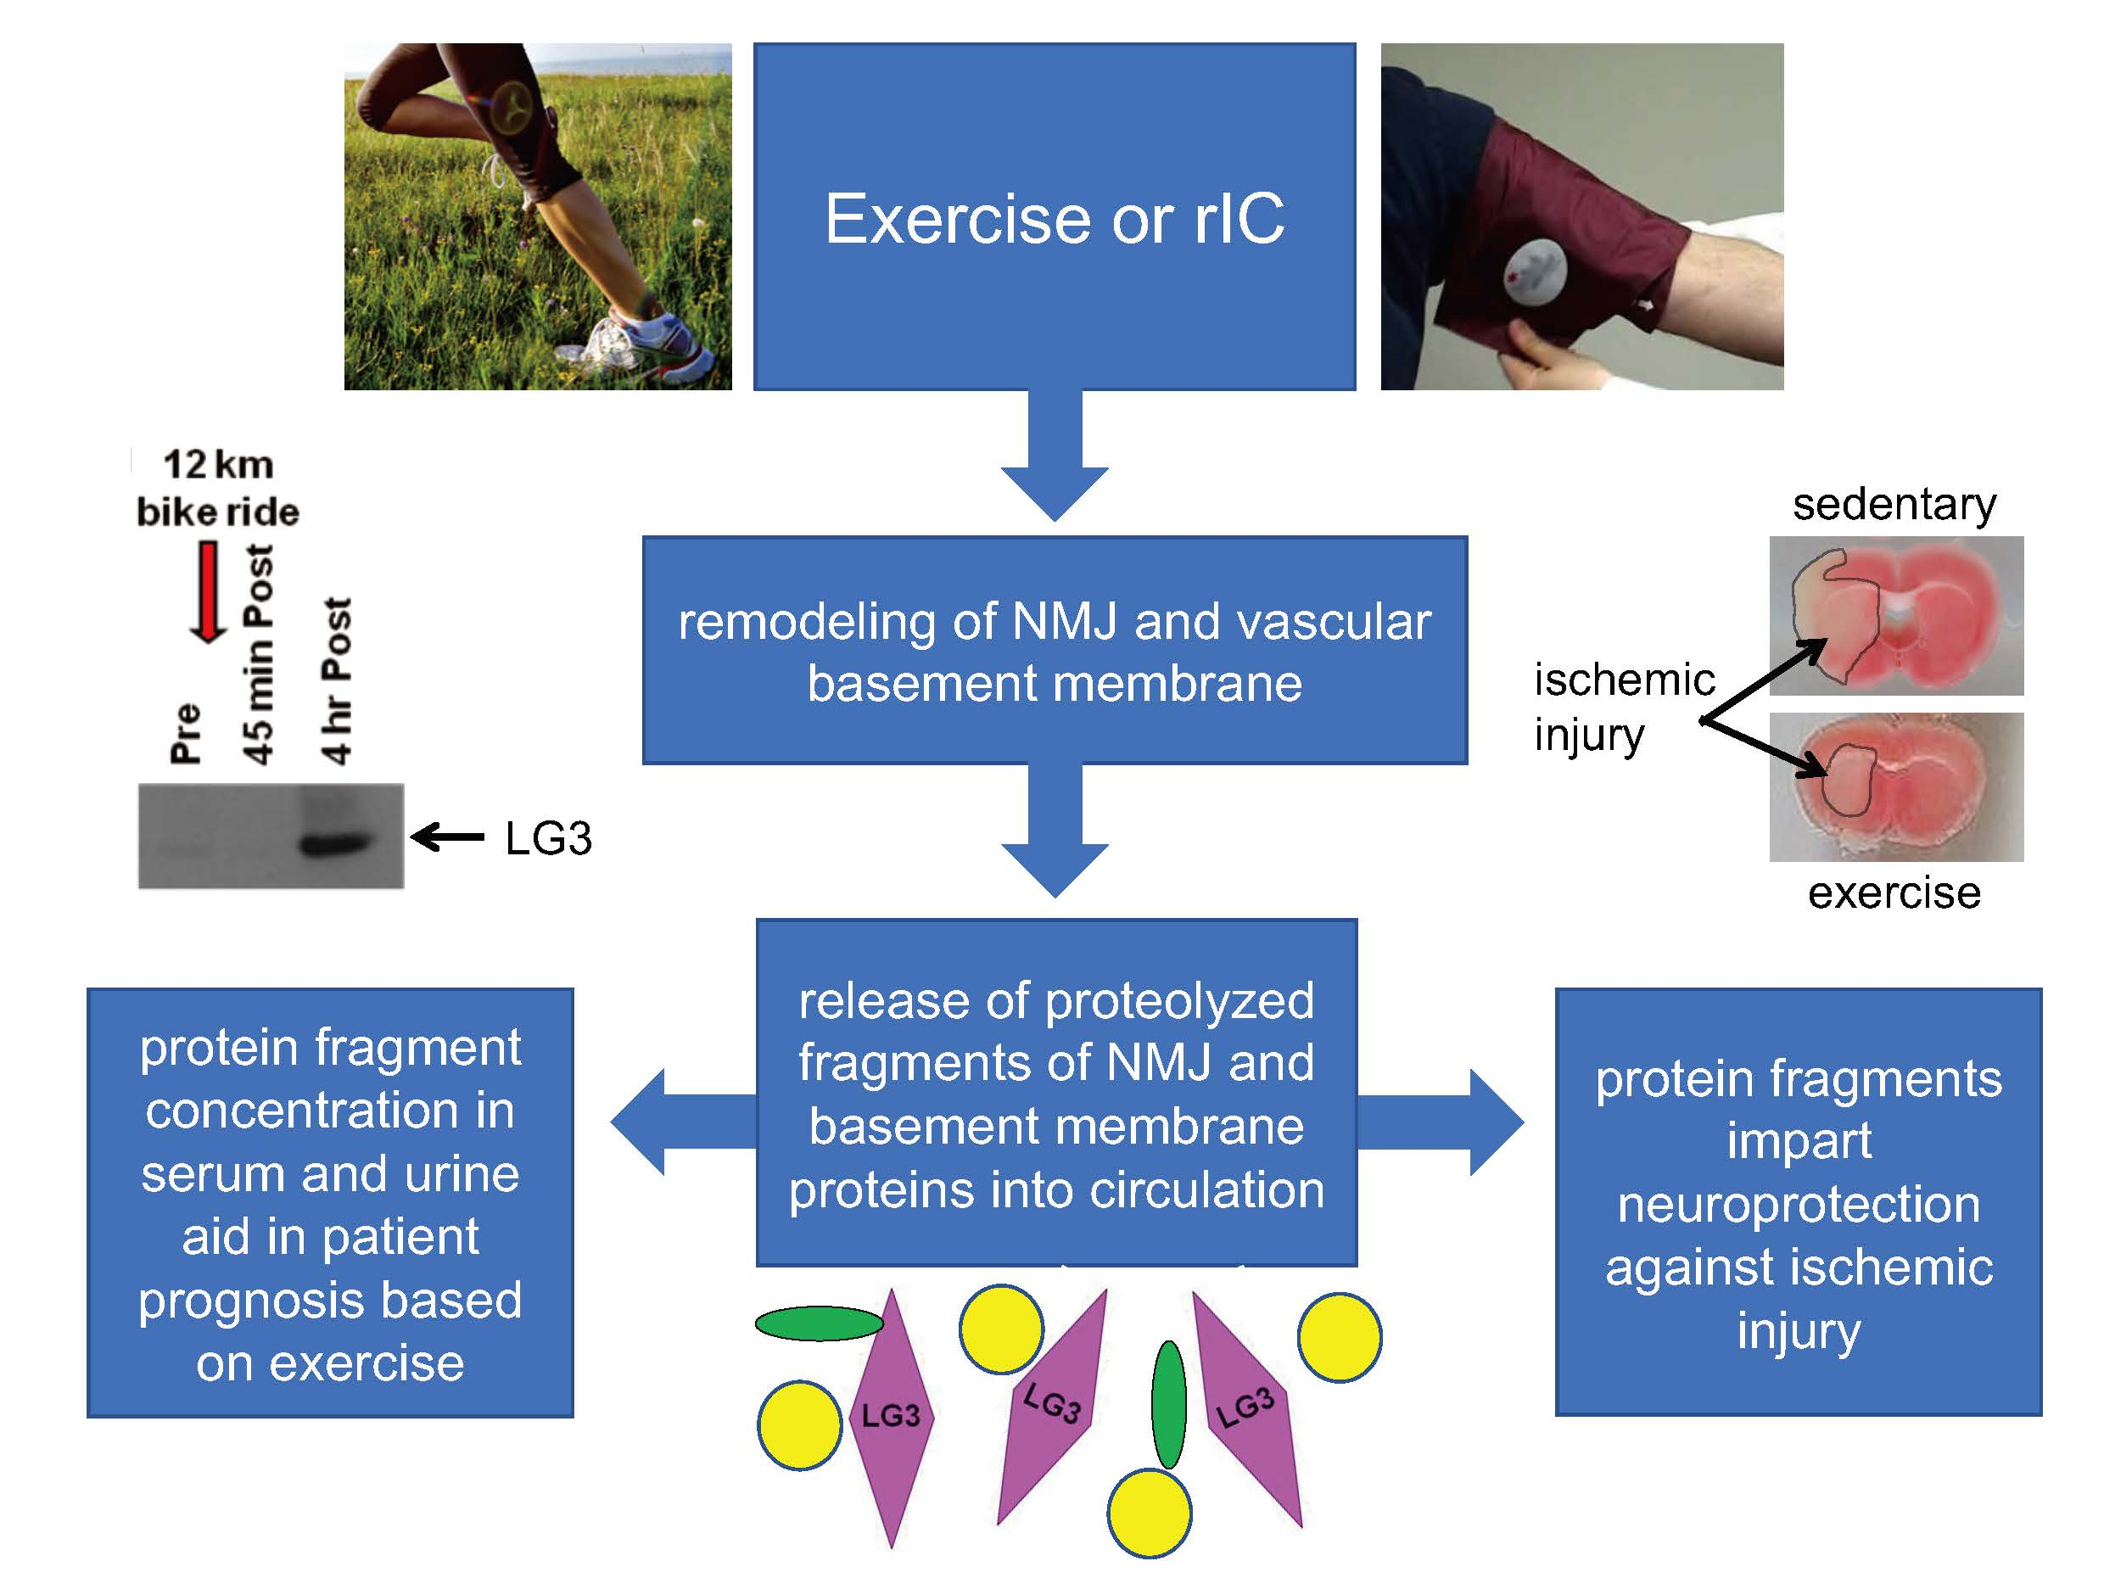
Figure 2:Schematic summarizing the overall hypothesis of this review.
Salmeron et al., Conditioning Medicine 2018; 1(2):98-104

