Slide 1
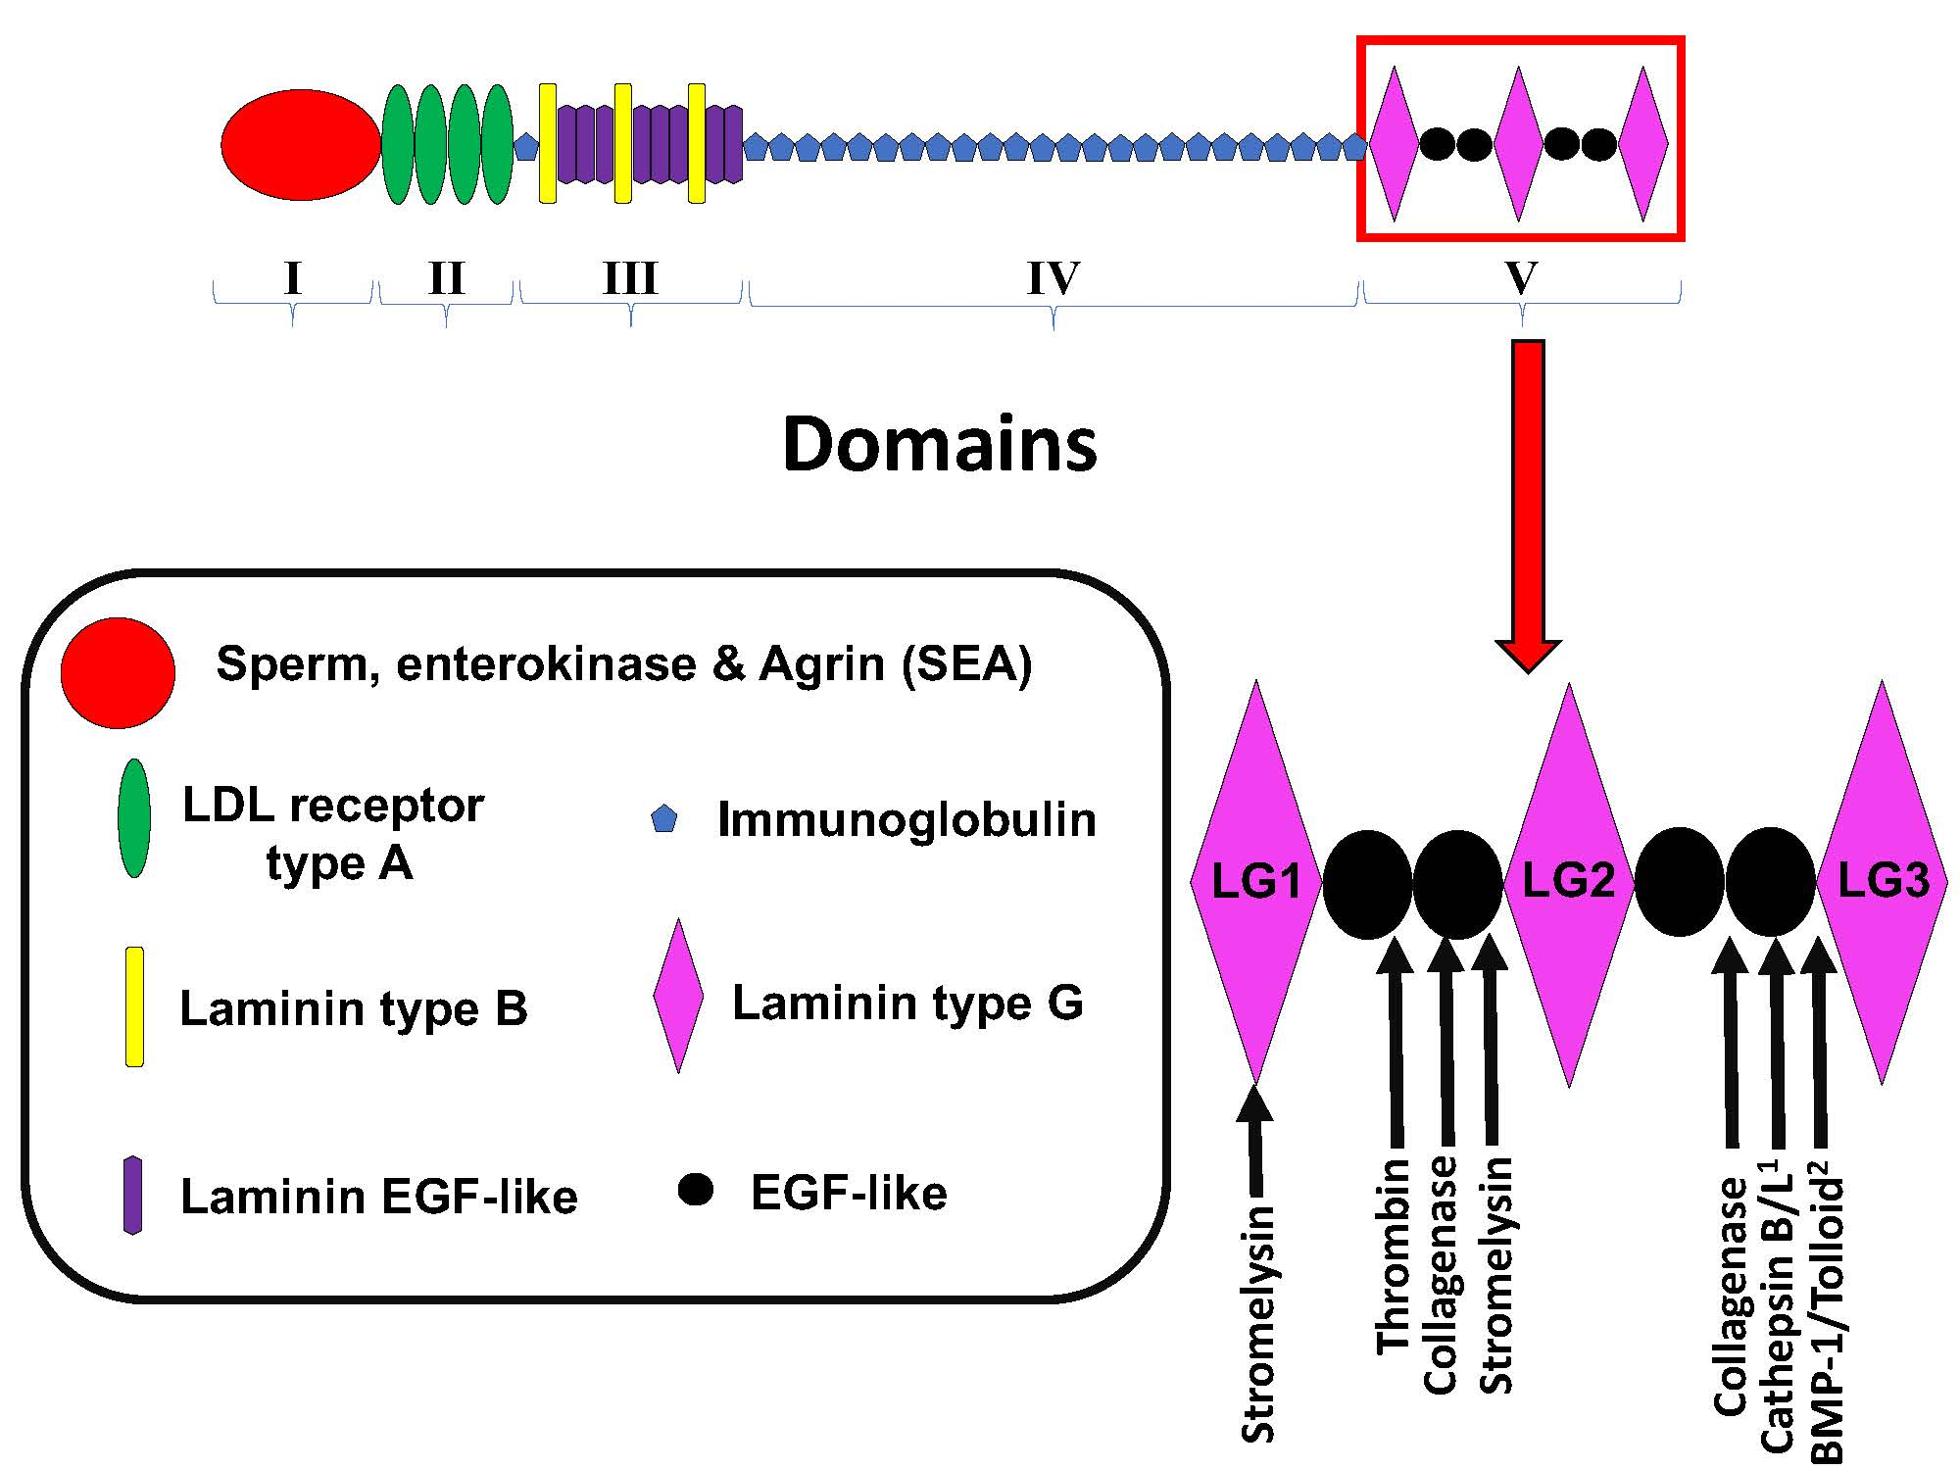
Figure 1: Schematic of perlecan’s domain structure and sites of Domain V proteolysis. Adapted from Roberts et al, 2012 1) Saini and Bix, 2012 2) Gonzalez et al, 2005.
Salmeron et al., Conditioning Medicine 2018; 1(2):98-104

