Slide 1
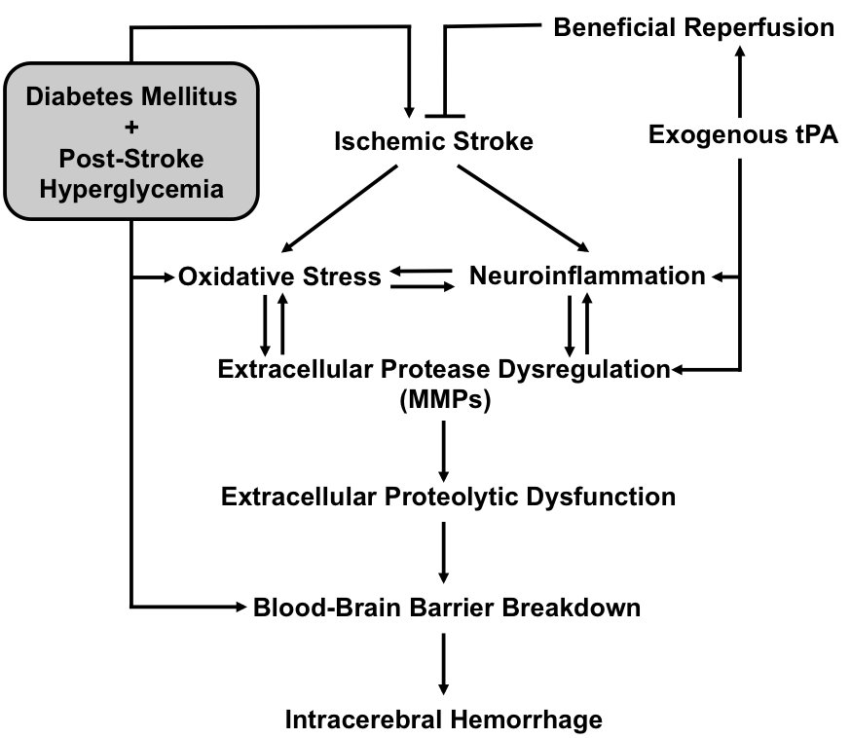
Figure 2.
Jiang et al., Conditioning Medicine 2019; 2(1):2-9.

