Slide 1
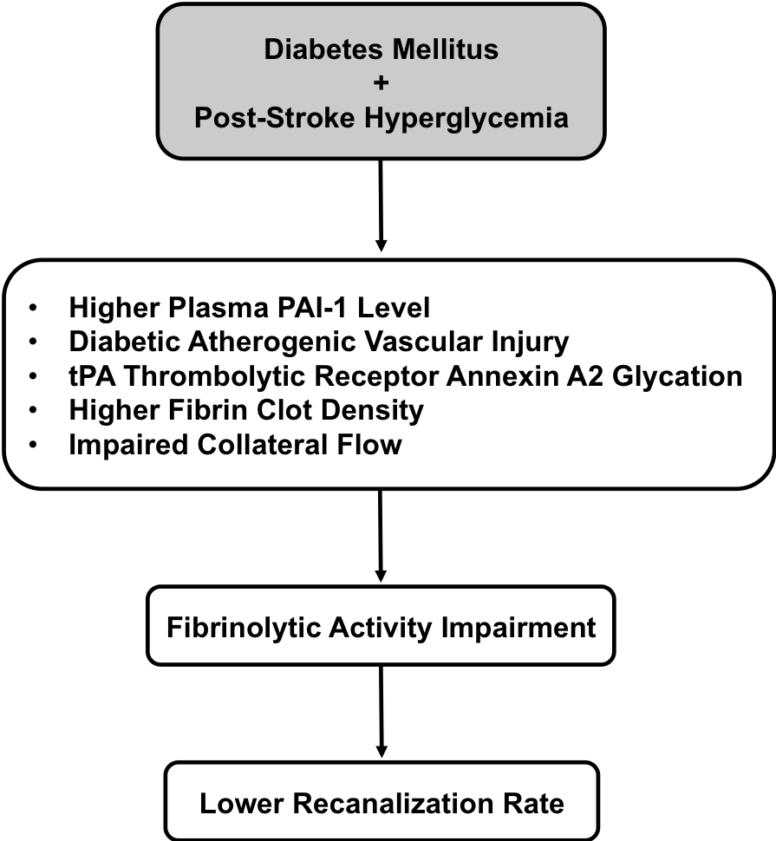
Figure 1. A schematic outline to link pathological association between diabetes mellitus plus post stroke hyperglycemia and lower recanalization rate after tPA thrombolytic stroke therapy. The potential pathological factors that underlying this therapeutic shortcoming include higher plasma PAI-1 level, diabetic atherogenic vascular injury, glycation of tPA thrombolytic receptor annexin A2, higher fibrin clot density, and impaired collateral flow. These factors all contribute to fibrinolytic activity impairment in exogenous tPA that clinically presents as a lower recanalization rate.
Jiang et al., Conditioning Medicine 2019; 2(1):2-9.

