Slide 1
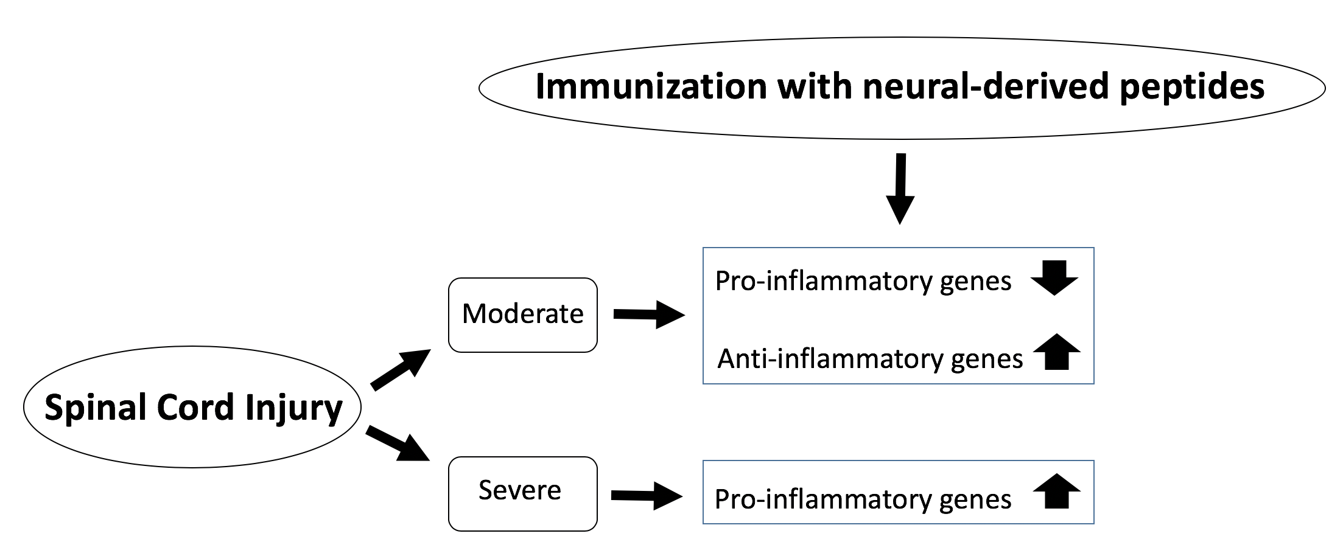
Figure 1. Schematic diagram of SCI severity and effects of INDP on inflammation
Antonio Ibarra and Elisa García, Conditioning Medicine 2018; 1(7):346-349.

