Slide 1
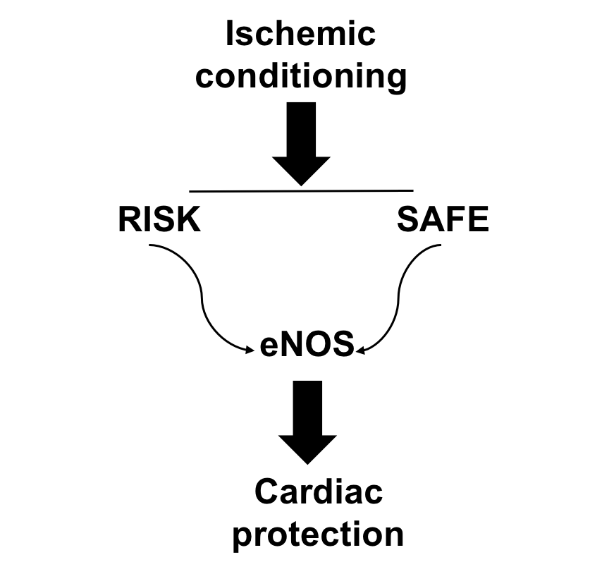
Figure 1. Schematic diagram of conditioning-induced cardiac protection.
Tatiana I. Baranich et al., Conditioning Medicine 2018; 1(7):343-345.

