Slide 1
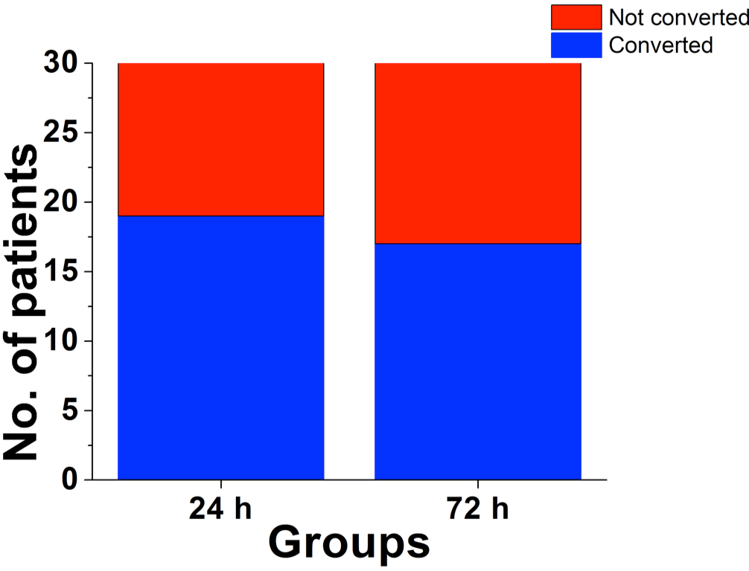
Figure 2. The rate of cardioconversion to sinus rhythm in the 24 and 72 h. groups.
Luis A. Sánchez-Trujillo et al., Conditioning Medicine 2018; 1(6):319-324.

