Slide 1
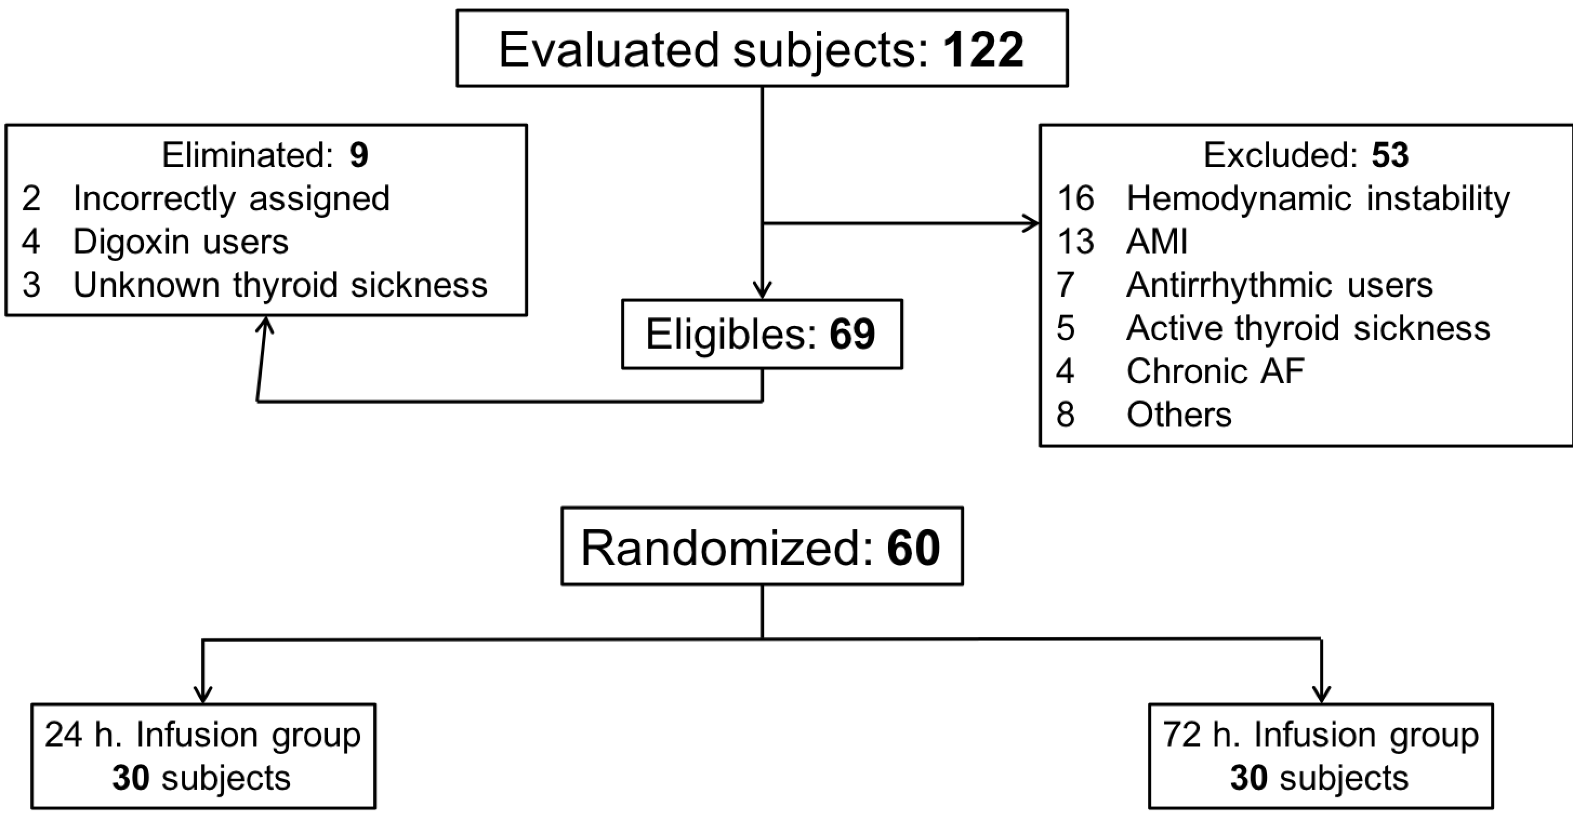
Figure 1. Flow diagram for inclusion/exclusion/elimination of patients in the randomized study.
Luis A. Sánchez-Trujillo et al., Conditioning Medicine 2018; 1(6):319-324.

