Slide 1
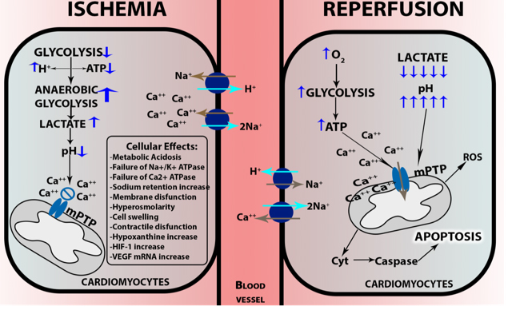
Figure 2. Cellular damage in ischemia-reperfusion.
Juan Alpuche et al., Conditioning Medicine 2018; 1(6):313-318.

