Slide 1
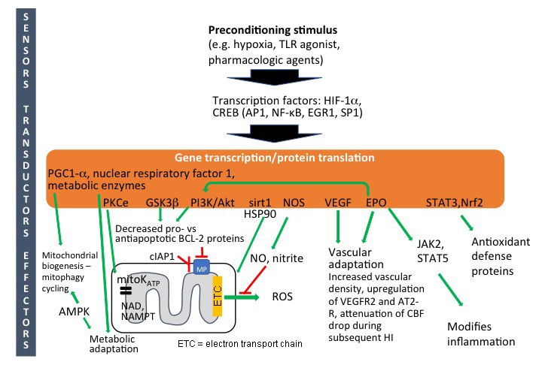
Figure 1. Intracellular mechanisms of preconditioning in neonatal brain.
Zinaida S. Vexler et al., Conditioning Medicine 2018; 1(6):279-293.

