Slide 1
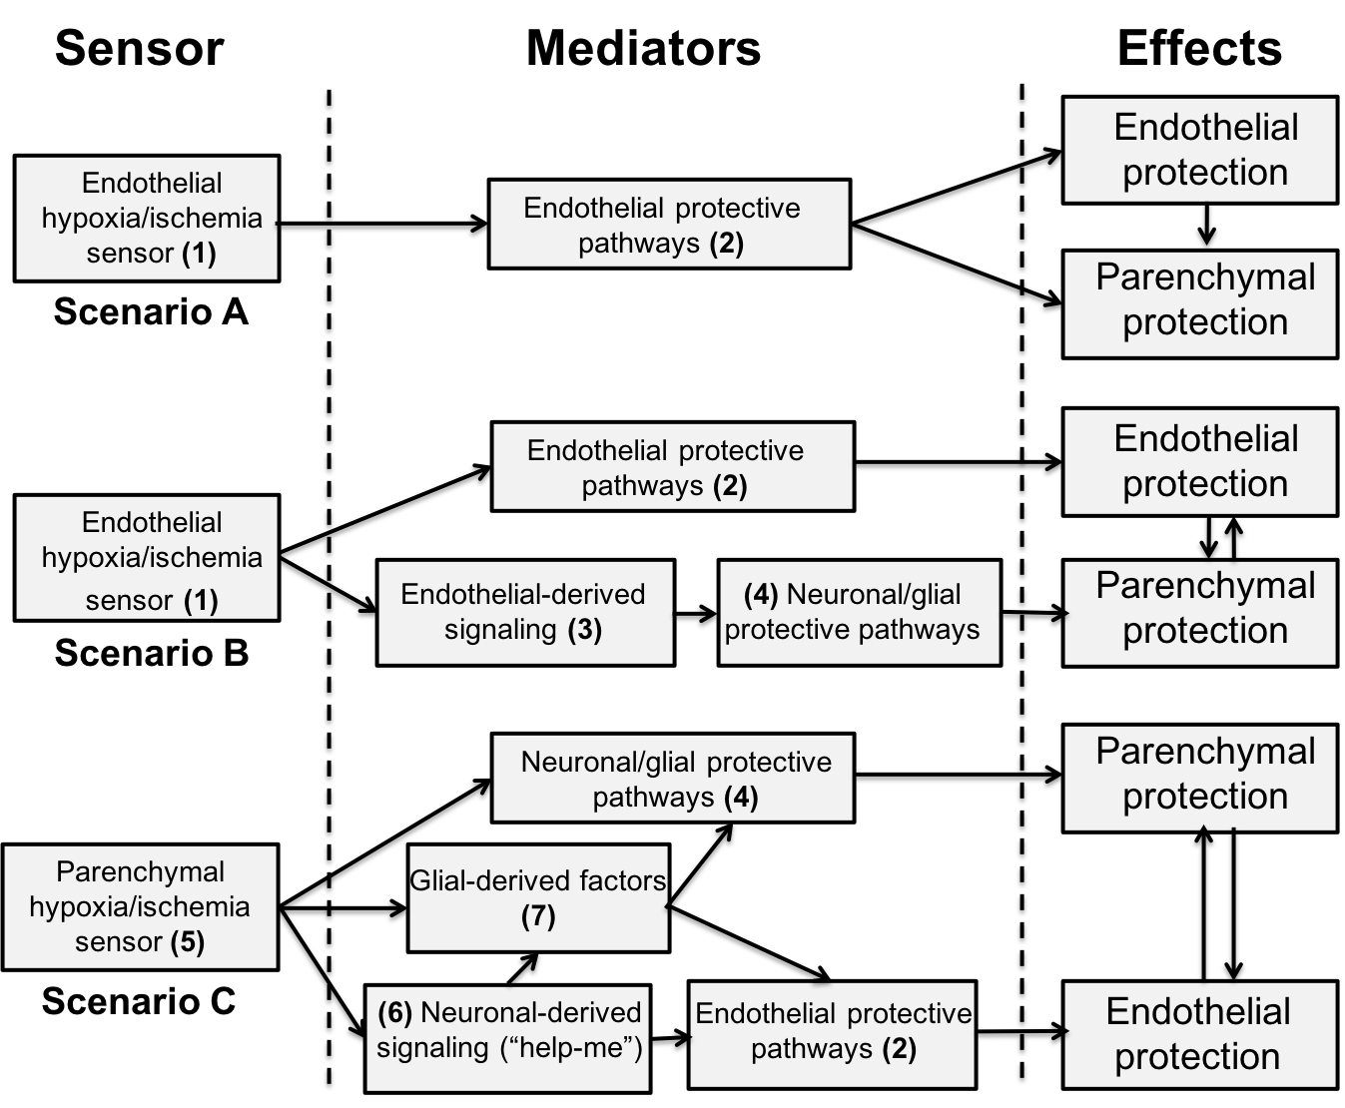
Figure 1. Schematic showing alternate roles of the cerebral endothelium in the brain response to ischemic/hypoxic conditioning stimuli.
Jianming Xiang et al., Conditioning Medicine 2018; 1(5):200-212

