Slide 1
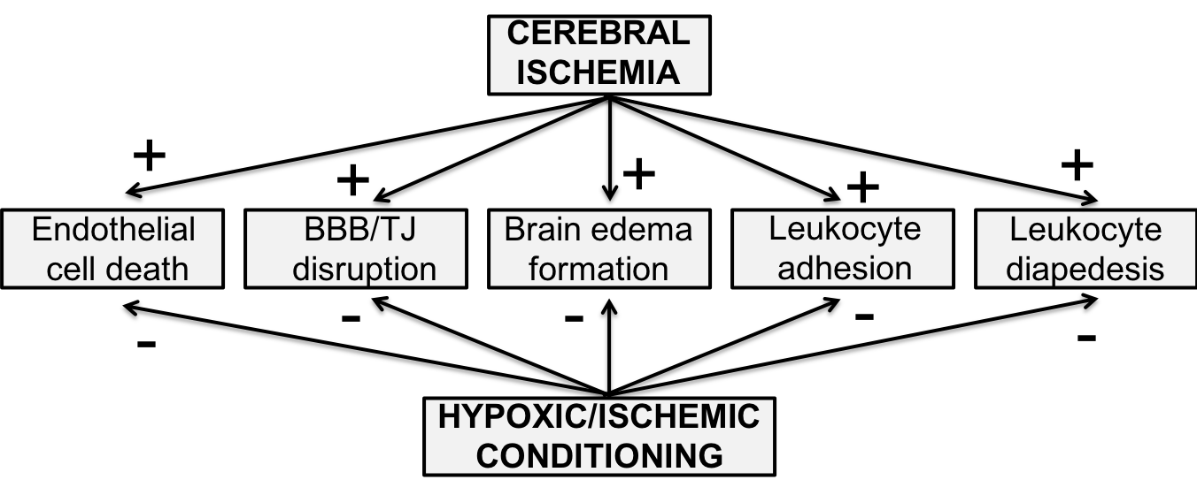
Figure 1. Effects of cerebral ischemia on the cerebral endothelium and blood-brain barrier (BBB) are reduced by ischemic or hypoxic conditioning stimuli (pre-, per- and post-conditioning). TJ: tight junction.
Jianming Xiang et al., Conditioning Medicine 2018; 1(5):200-212

