Slide 1
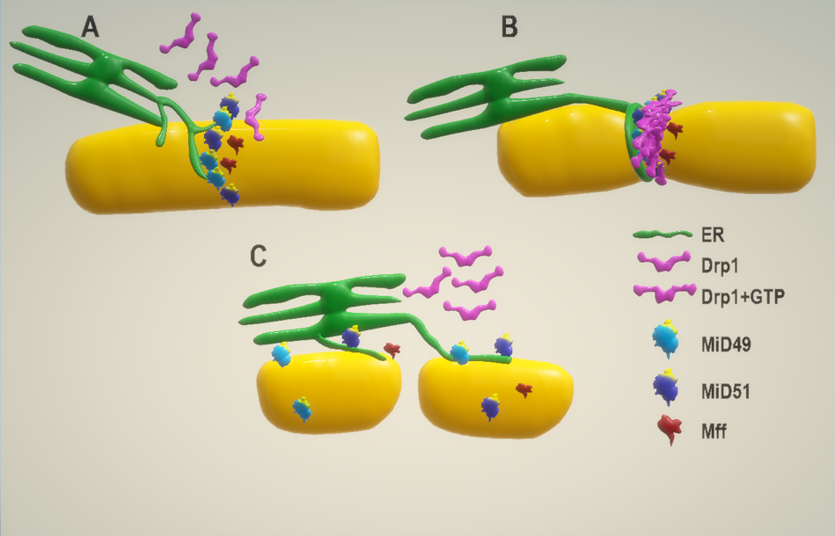
Figure 3: Mitochondrial ER interaction is essential for and Drp1 mediated fission.
Parisa Samangouei et al., Conditioning Medicine 2018; 1(5):239-246

