Slide 1
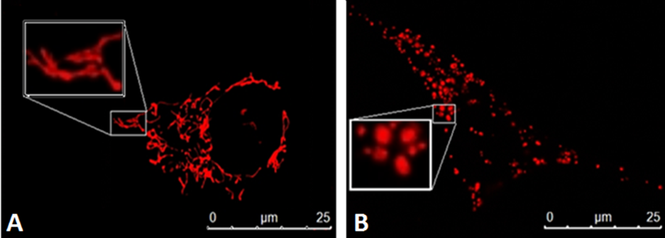
Figure 1: Fusion and Fission are essential for cellular health and function.
Parisa Samangouei et al., Conditioning Medicine 2018; 1(5):239-246

