Slide 1
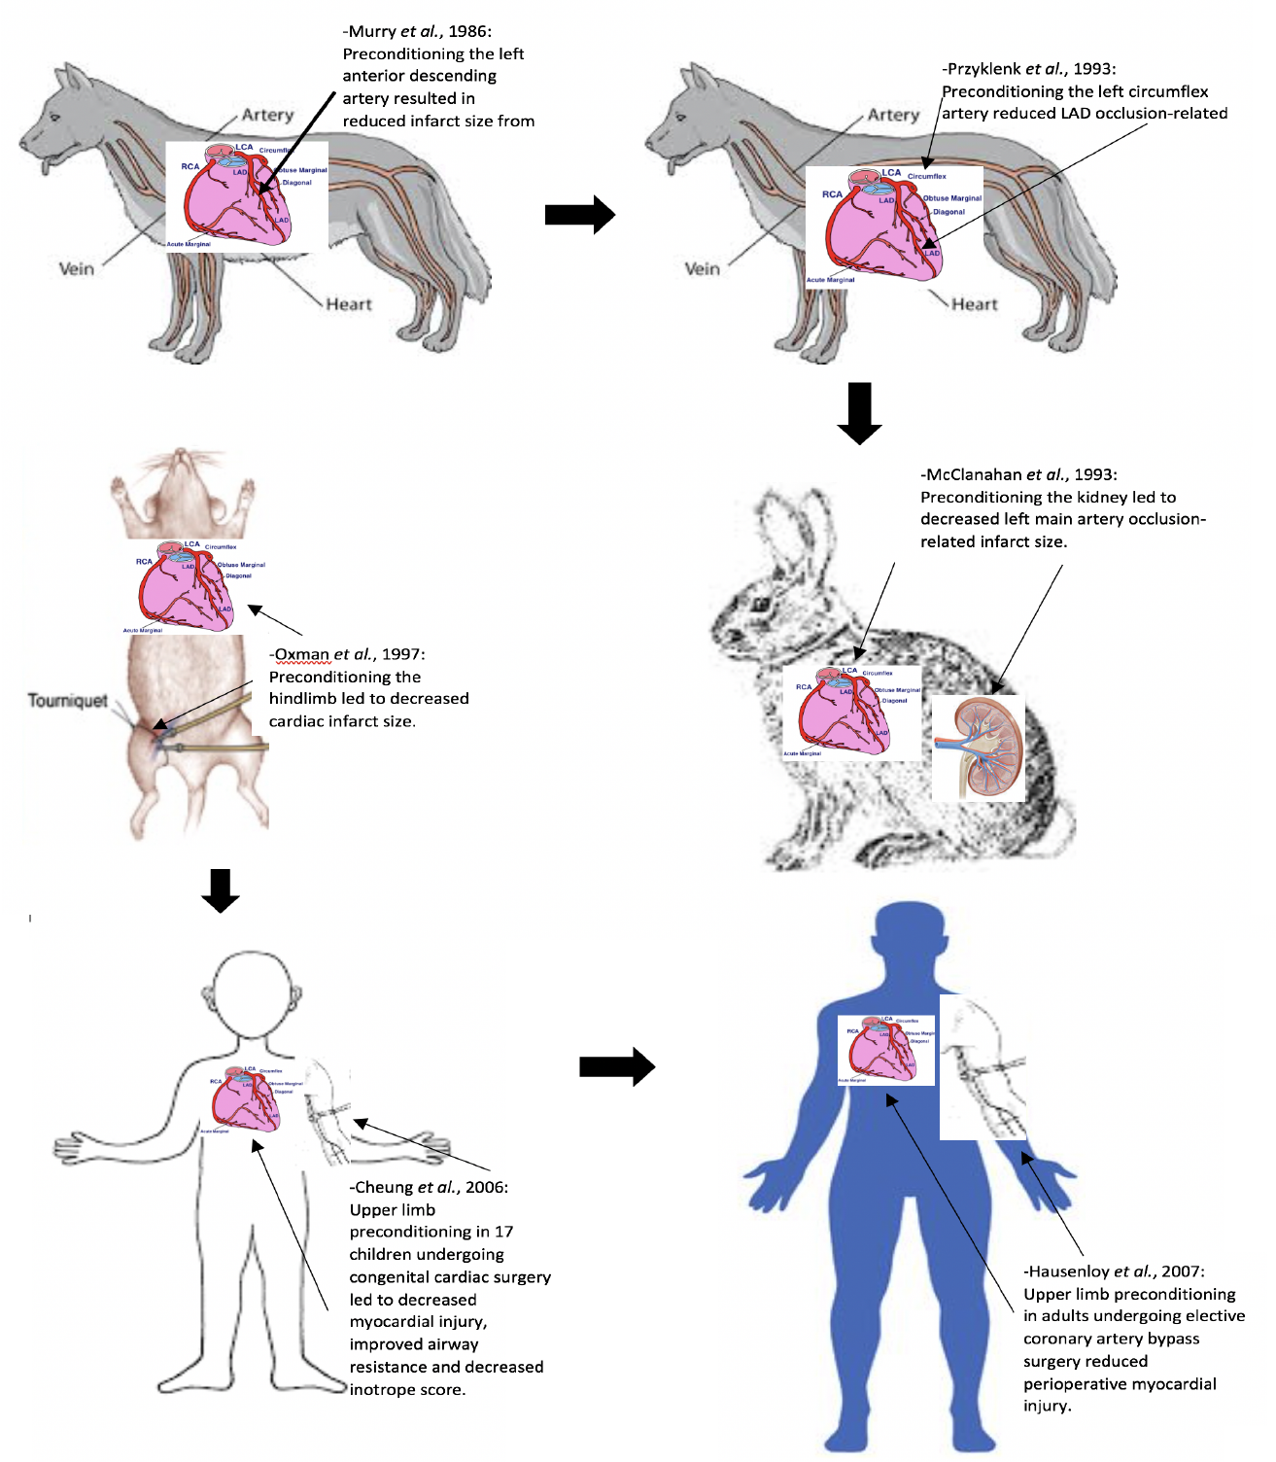
Figure 1. This figure shows the timeline of translation of RIC from experimental to clinical studies.
Jun Chong et al., Conditioning Medicine 2018; 1(5):213-222

