Slide 1
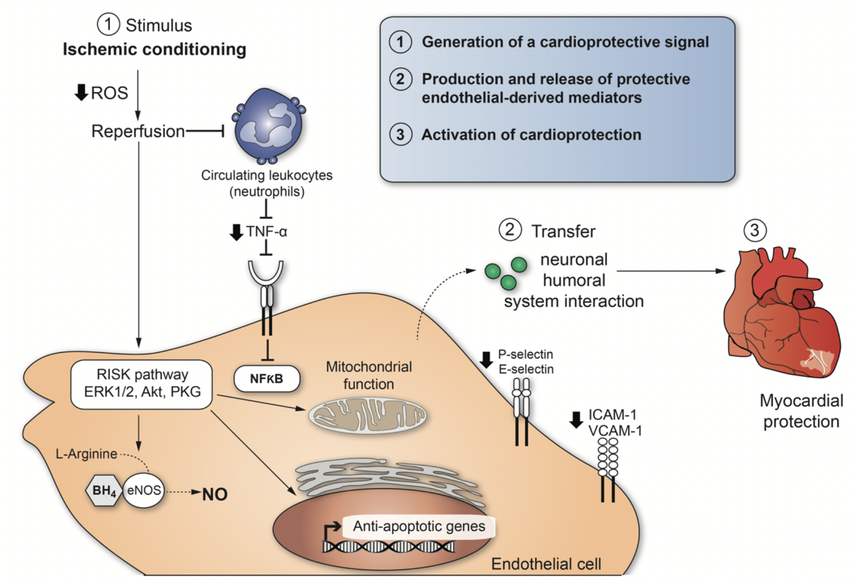
Figure 2: Cardio-protective mediators and molecular mechanisms that are activated by ischemic conditioning in endothelial cells.
Sauri Hernández-Reséndiz et al., Conditioning Medicine 2018; 1(5):247-258

