Slide 1
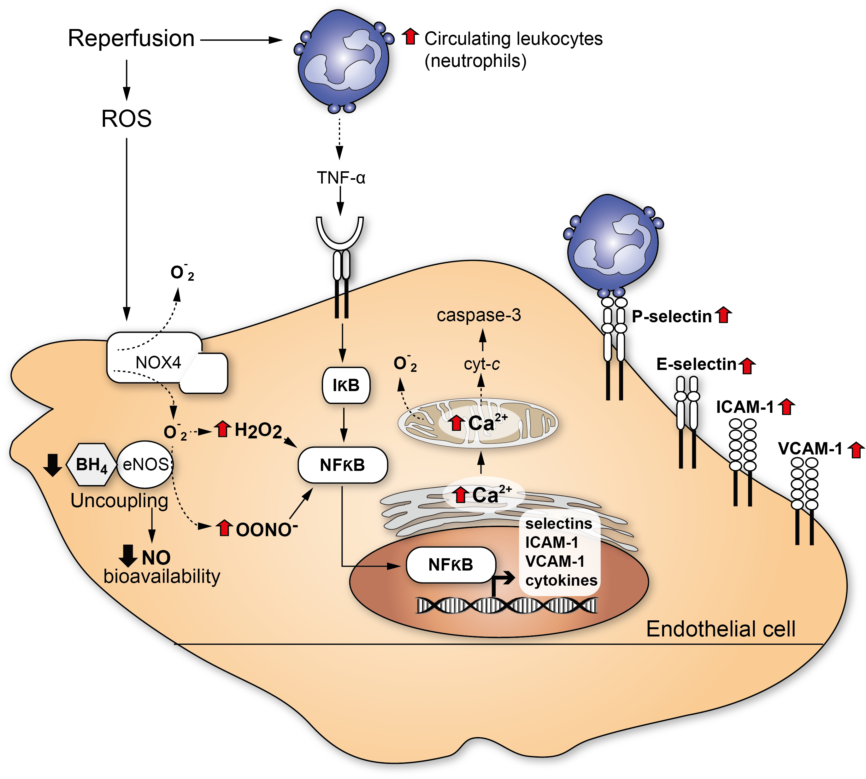
Figure 1: Overview of endothelial cell response towards acute myocardial infarction.
Sauri Hernández-Reséndiz et al., Conditioning Medicine 2018; 1(5):247-258

