Slide 1
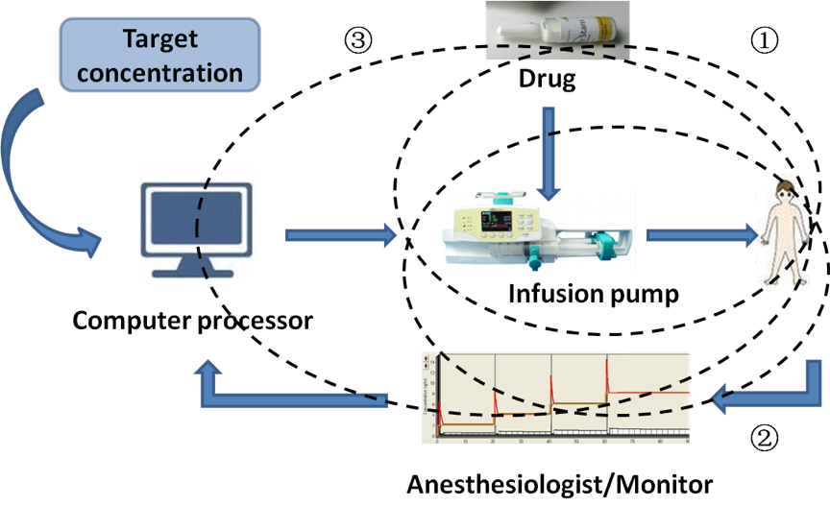
Figure 2: Advances in anesthetic drug delivery system.
Tingting Huang et al., Conditioning Medicine 2018; 1(5):223-238

