Slide 1
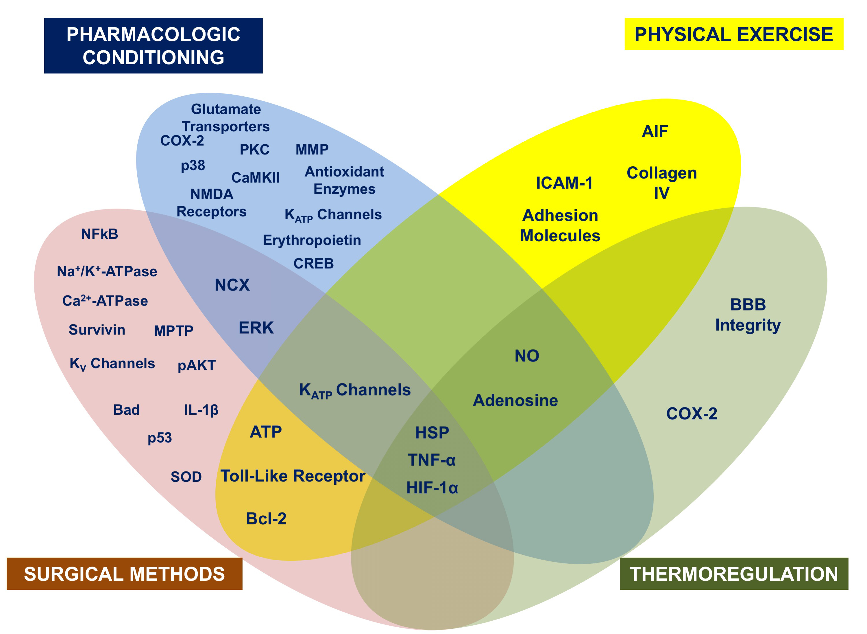
Figure 5: Shared mediators of neuroprotection elicited by different preconditioning stimuli.
Cuomo et al., Conditioning Medicine 2018; 1(4):167-183

