Slide 1
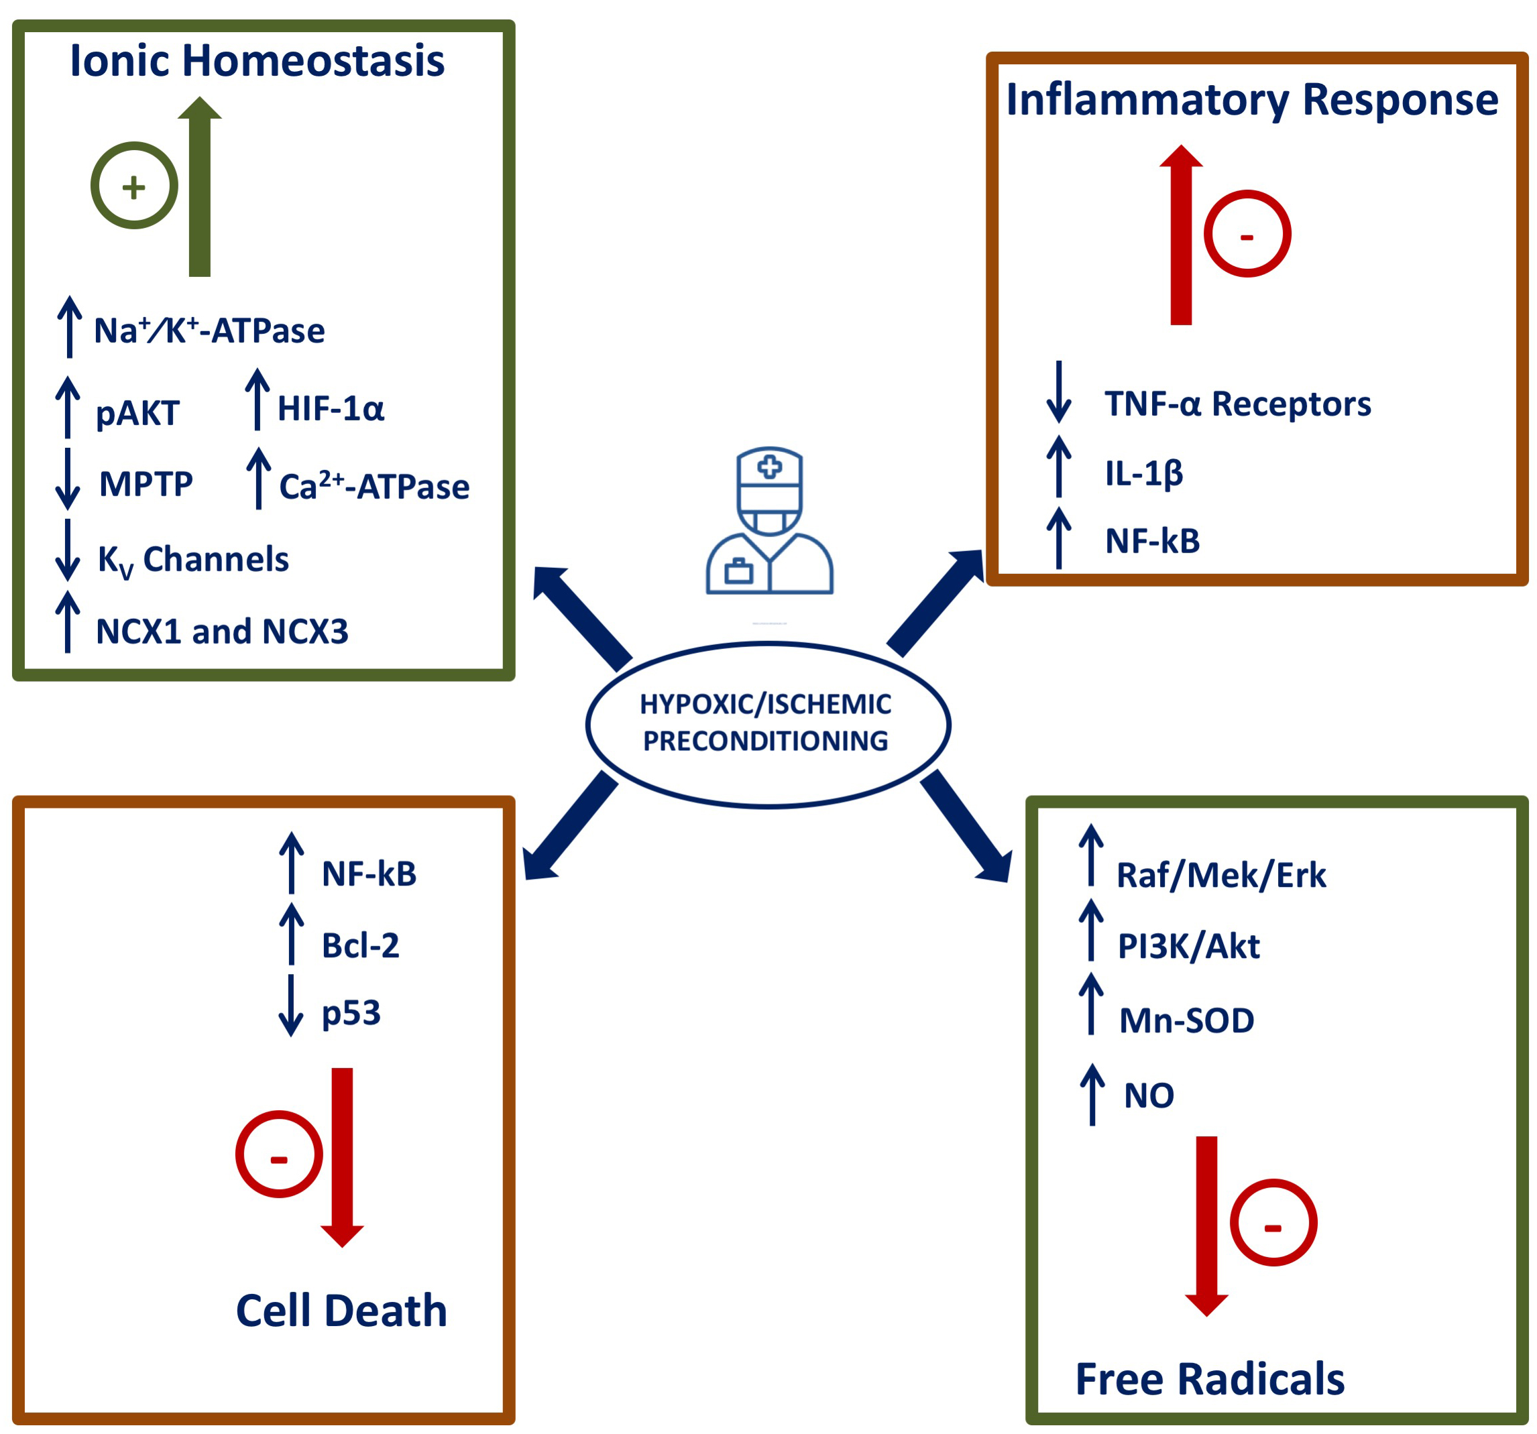
Figure 4: Neuroprotective molecular mechanisms and mediators activated by hypoxia/ischemia-induced brain conditioning.
Cuomo et al., Conditioning Medicine 2018; 1(4):167-183

