Slide 1
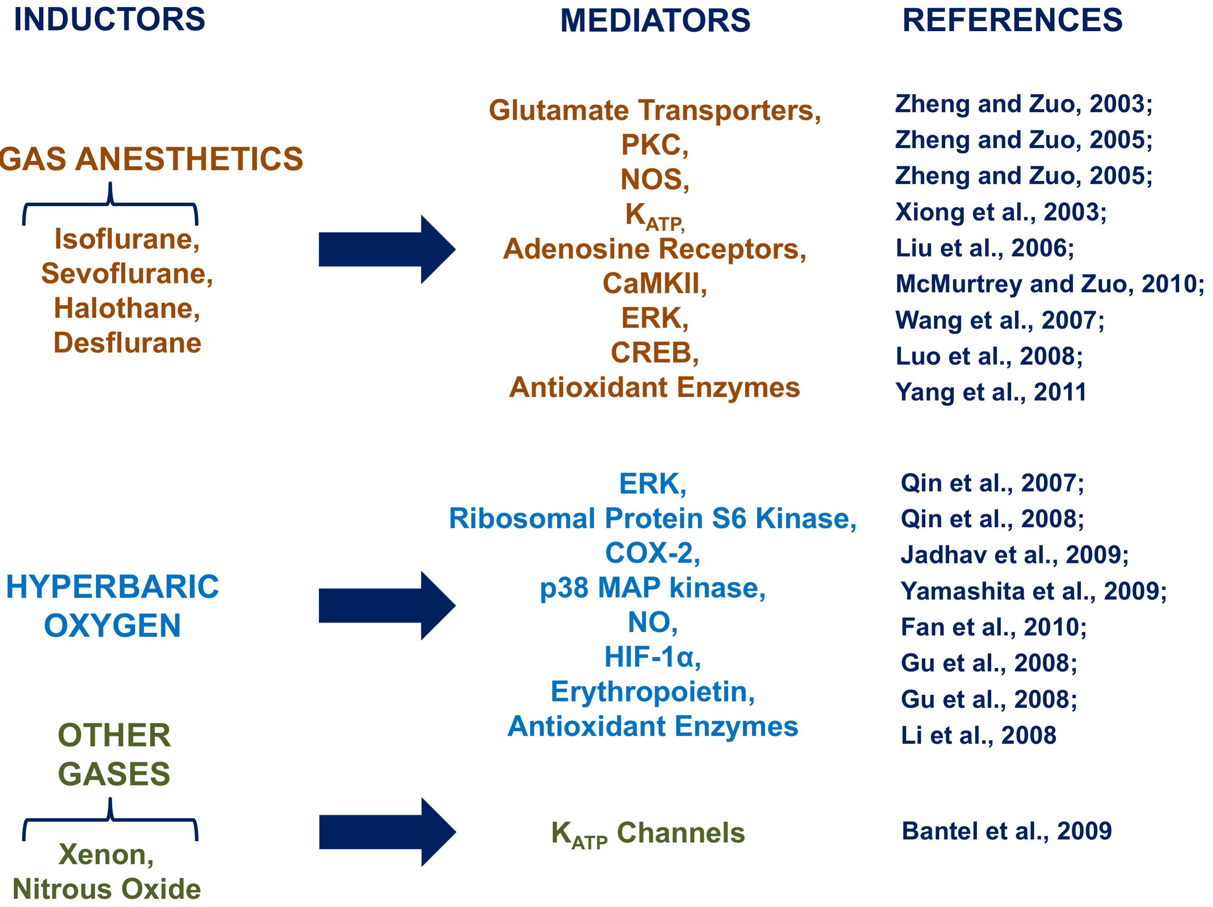
Figure 3: Neuroprotective molecular mechanisms and mediators activated by medical gas-induced brain conditioning.
Cuomo et al., Conditioning Medicine 2018; 1(4):167-183

