Slide 1
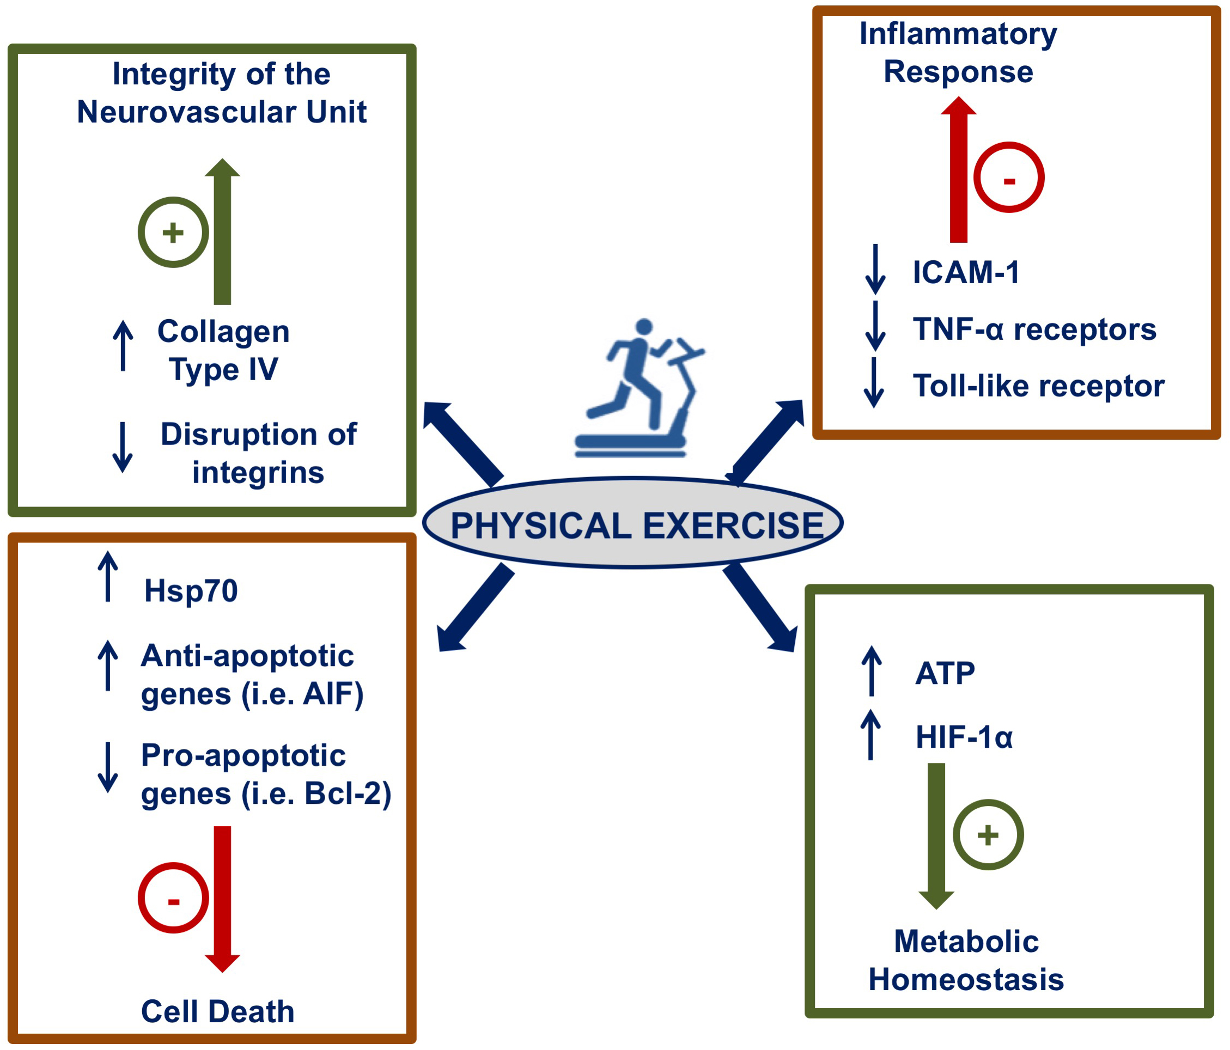
Figure 1: Neuroprotective molecular mechanisms and mediators activated by physical exercise-induced brain conditioning.
Cuomo et al., Conditioning Medicine 2018; 1(4):167-183

