Slide 1
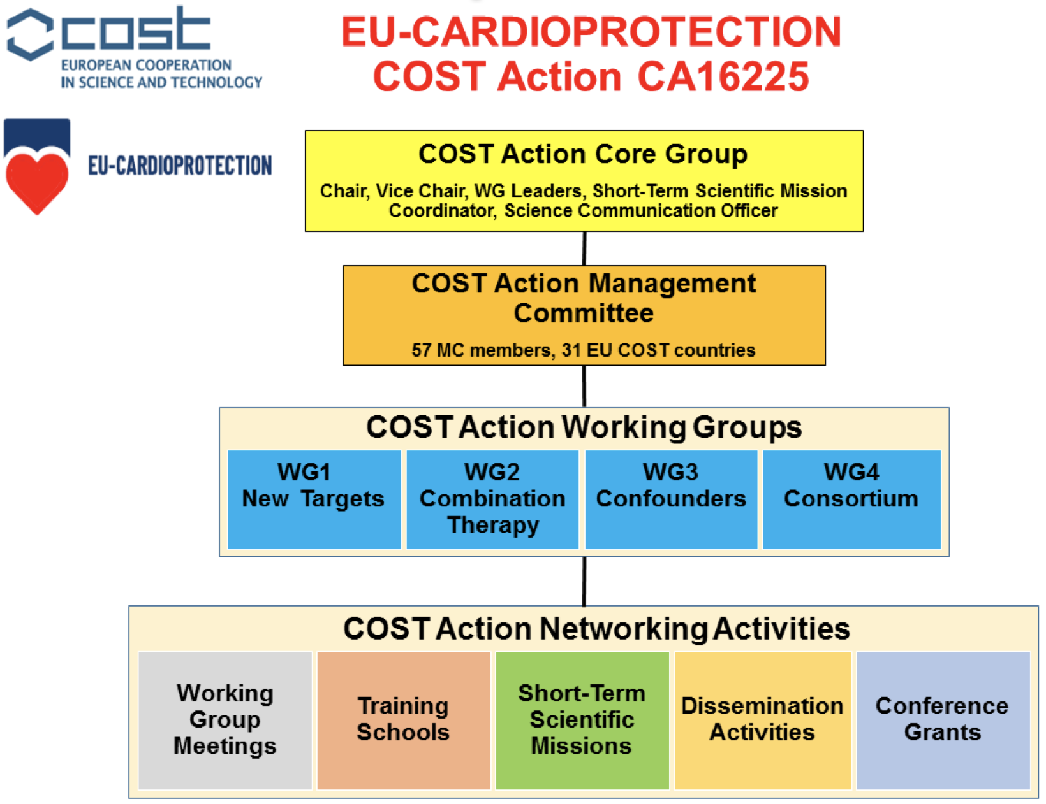
Figure 1: Overview of the EU-CARDIOPROTECTION COST Action CA16225 organization and activities.
Andreadou et al., Conditioning Medicine 2018; 1(3):116-123

