Slide 1
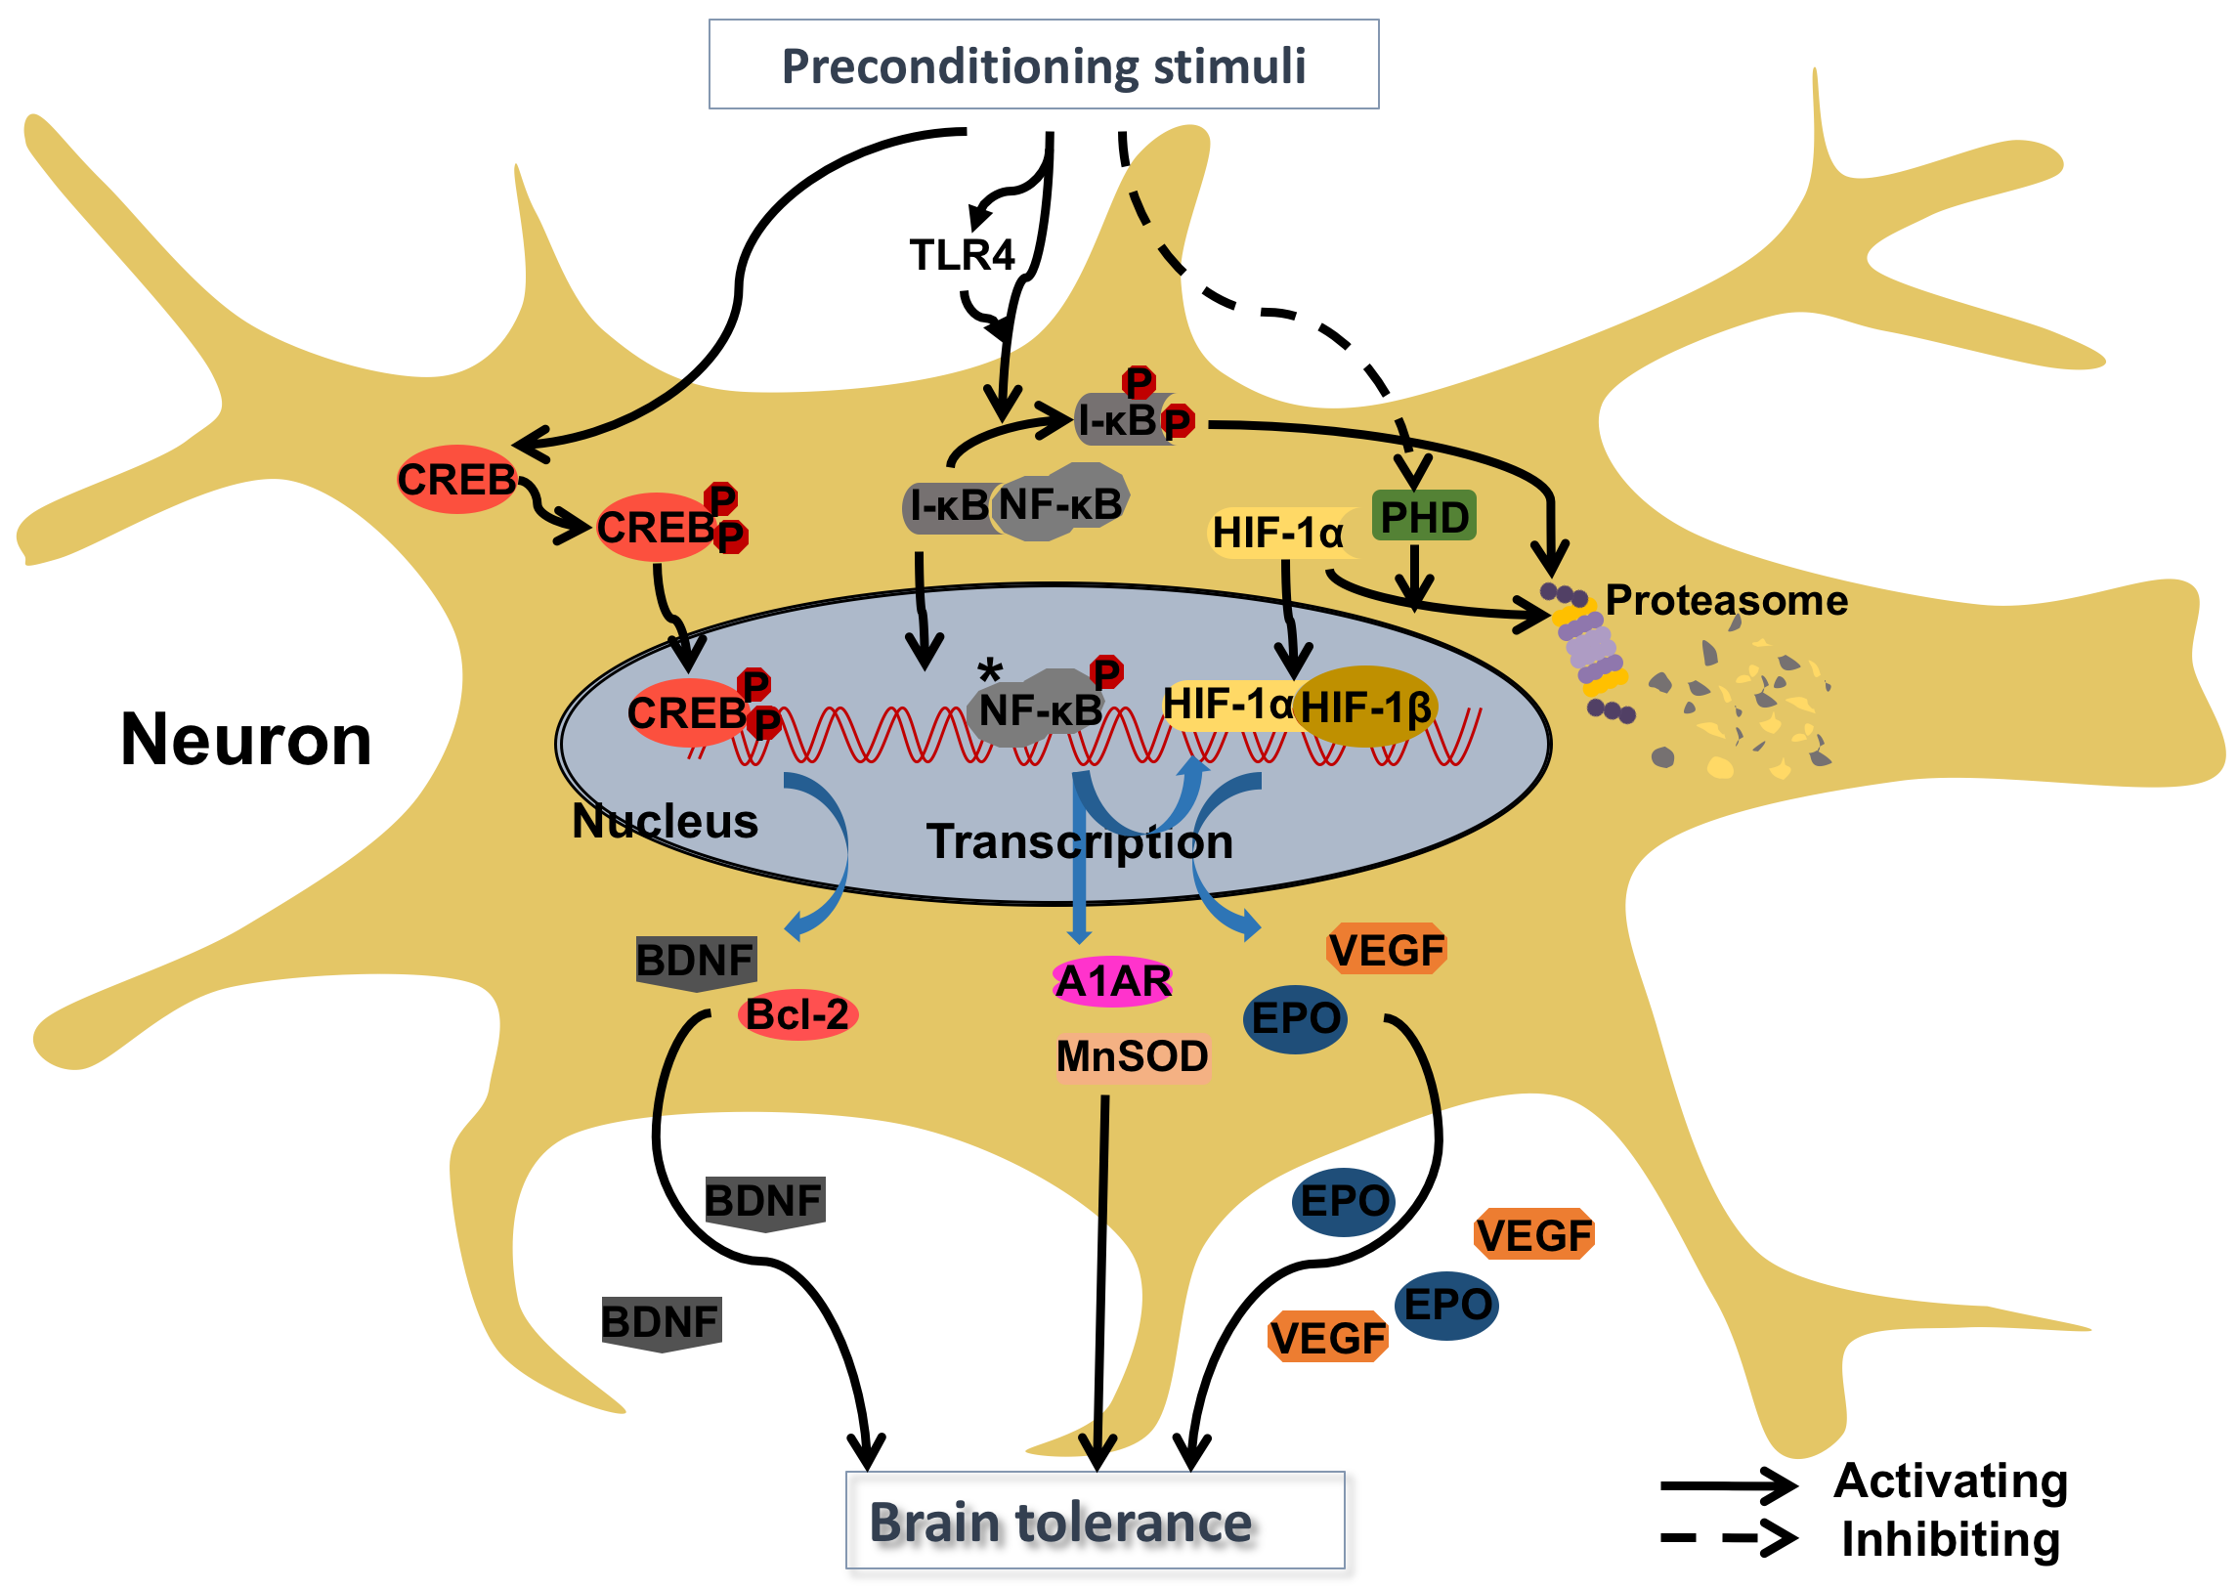
Figure 1: Neuroprotective pathways associated with transcriptional transactivation following preconditioning stimuli.
Yu et al., Conditioning Medicine 2018; 1(3):135-142

