Slide 1
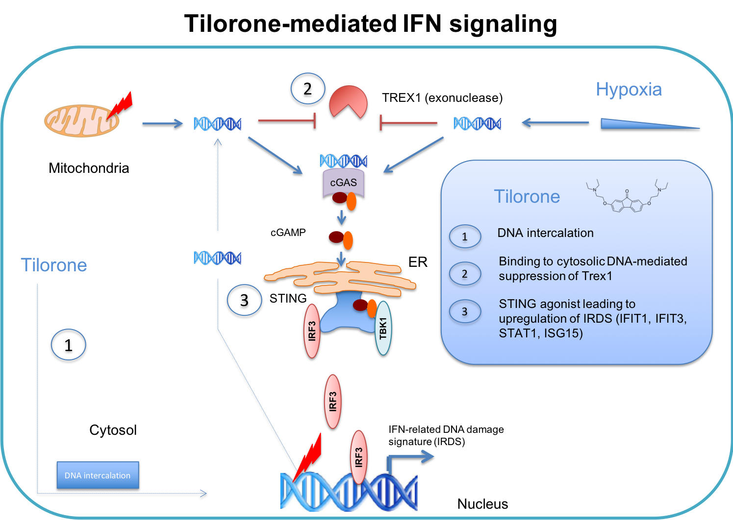
Figure 2: Schematic diagram illustrates how tilorone and hypoxia may share common mechanisms in the mediation of the preconditioning response.
Karuppagounder et al., Conditioning Medicine 2018; 1(4):143-150

