Slide 1
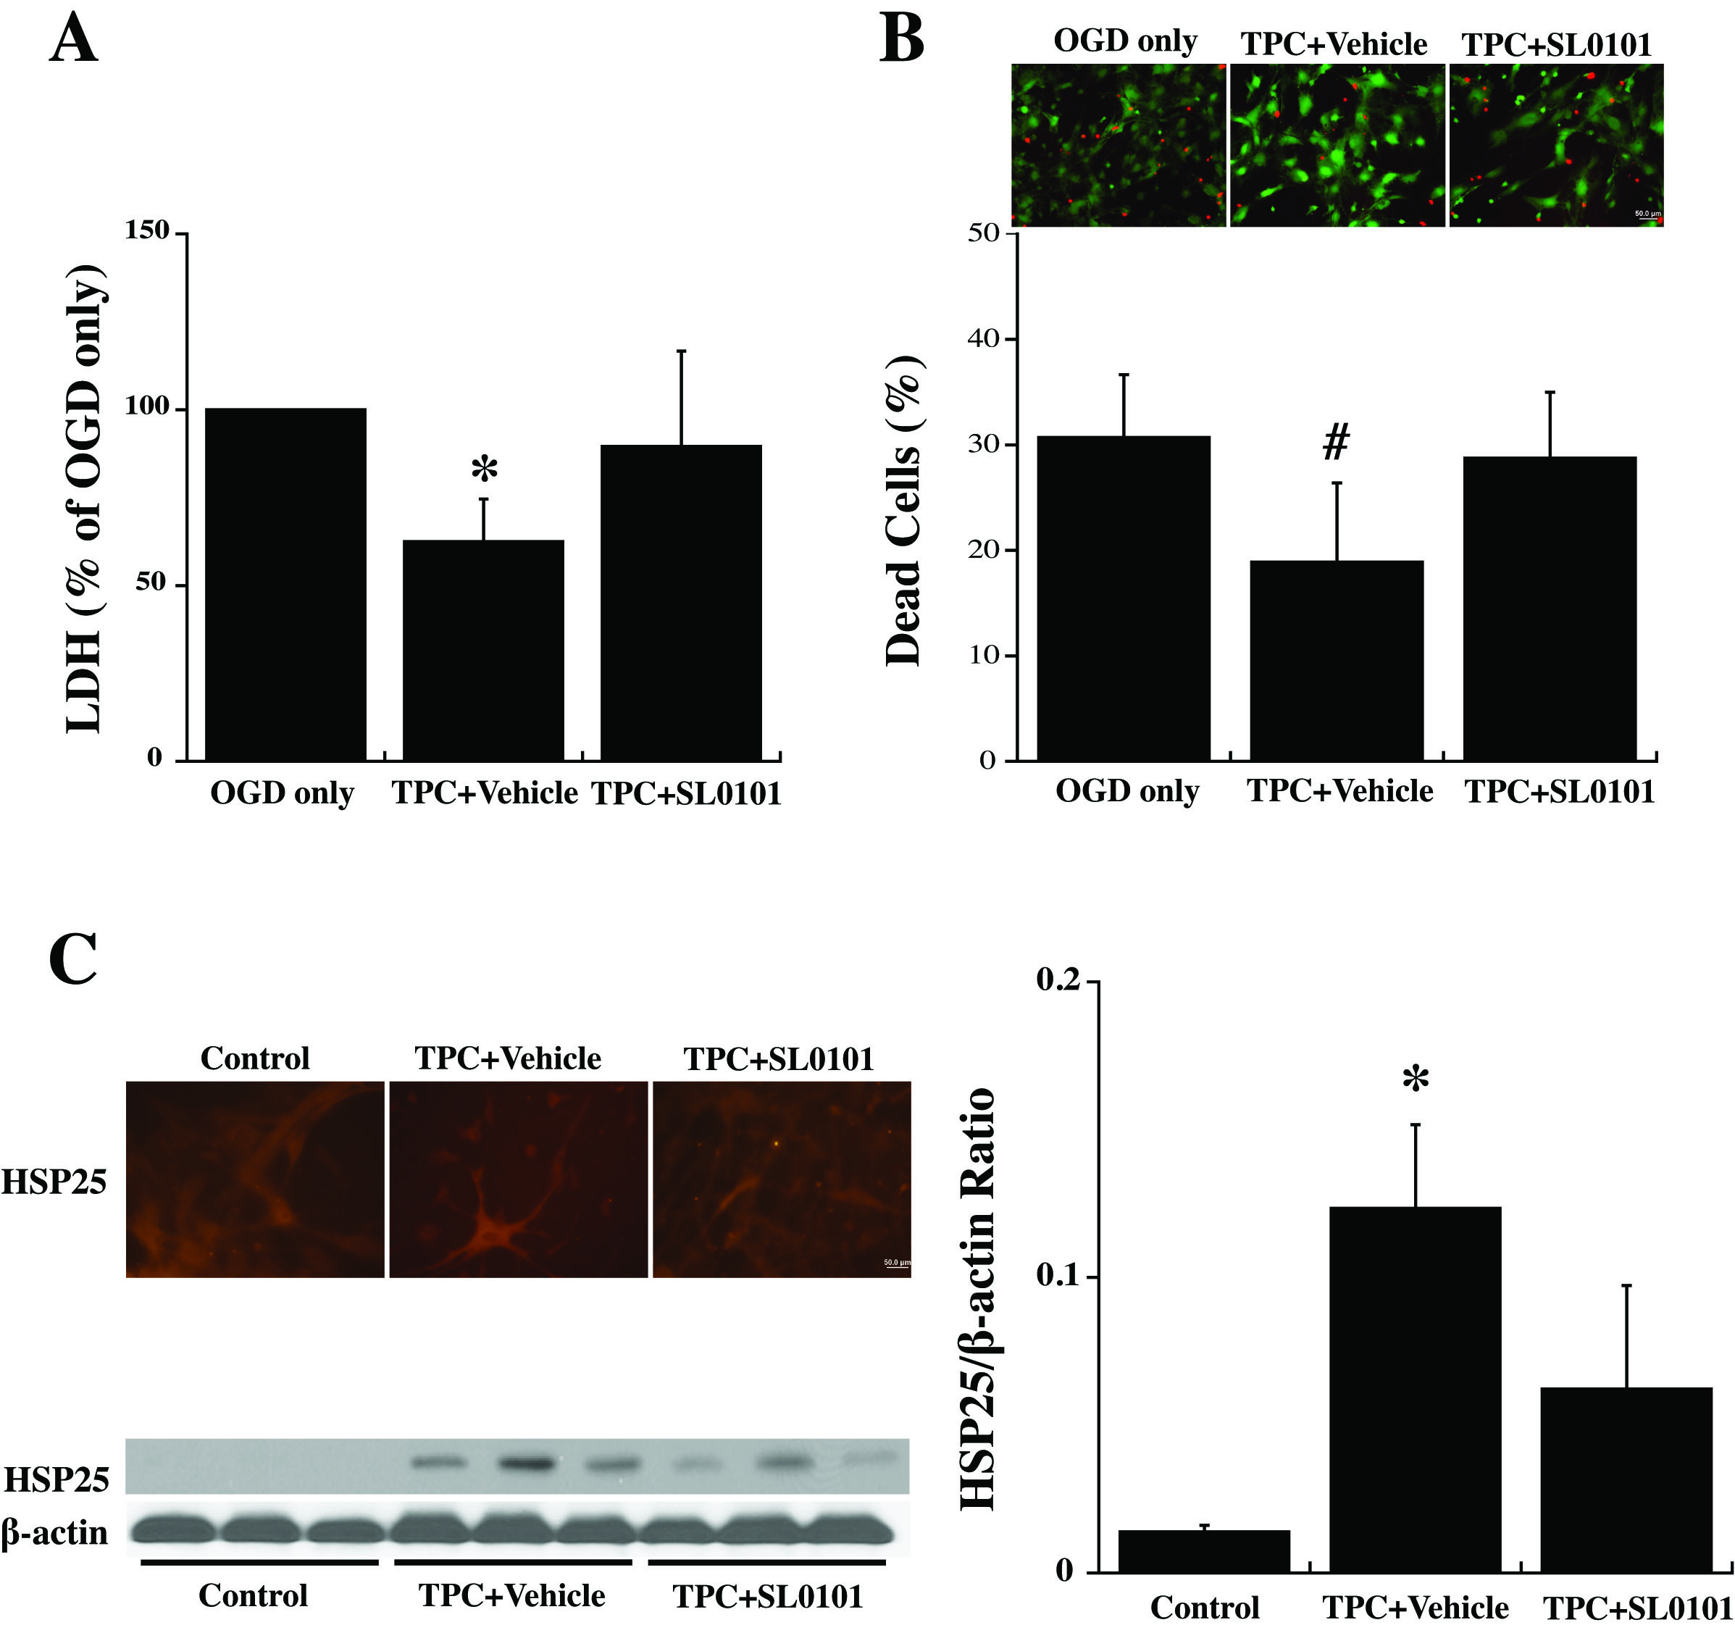
Figure 6: Primary cultured WT mouse astrocytes were pretreated with SL0101 (100 μM), an inhibitor of p90RSK, or vehicle for 3 hours before 24 hours thrombin (0.5 U/ml) treatment (TPC).
Bao et al., Conditioning Medicine 2018; 1(2):57-63

