Slide 1
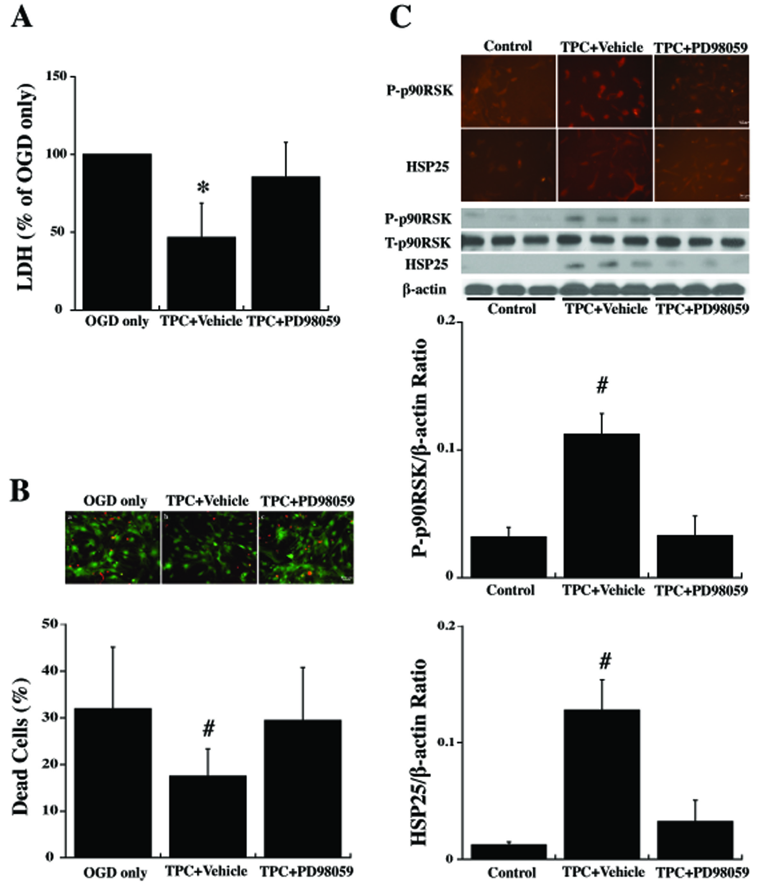
Figure 5: Primary cultured WT mouse astrocytes were pretreated with PD98059 (20 μM) an inhibitor of p44/42 MAPK, or vehicle for 30 min before 24 hours thrombin (0.5 U/ml) treatment (TPC).
Bao et al., Conditioning Medicine 2018; 1(2):57-63

