Slide 1
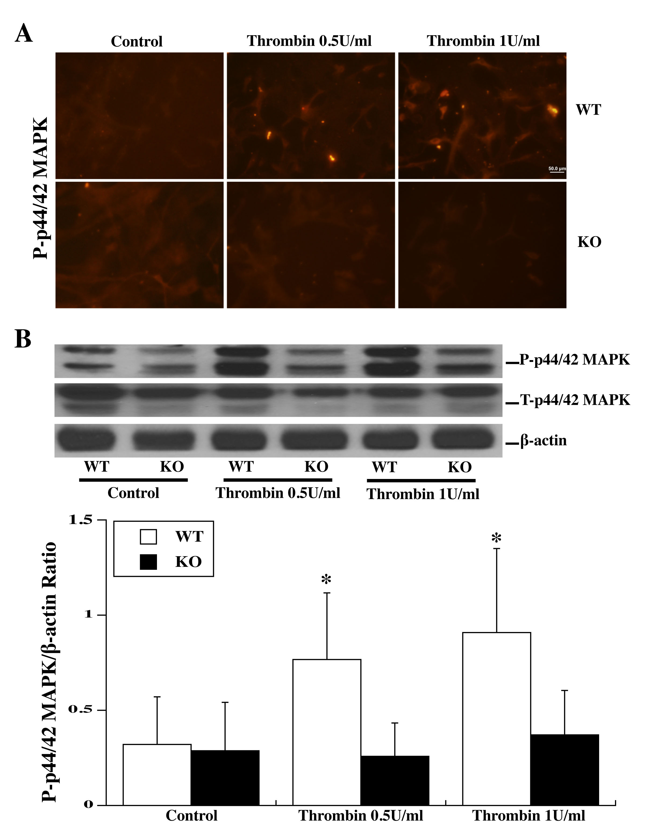
Figure 2: Primary astrocyte cultures from WT and PAR-1 KO mice were pretreated with two doses of thrombin (0.5 and 0.1 U/ml) for 24 h and then collected for immunofluorescence staining and Western blot analysis.
Bao et al., Conditioning Medicine 2018; 1(2):57-63

