Slide 1
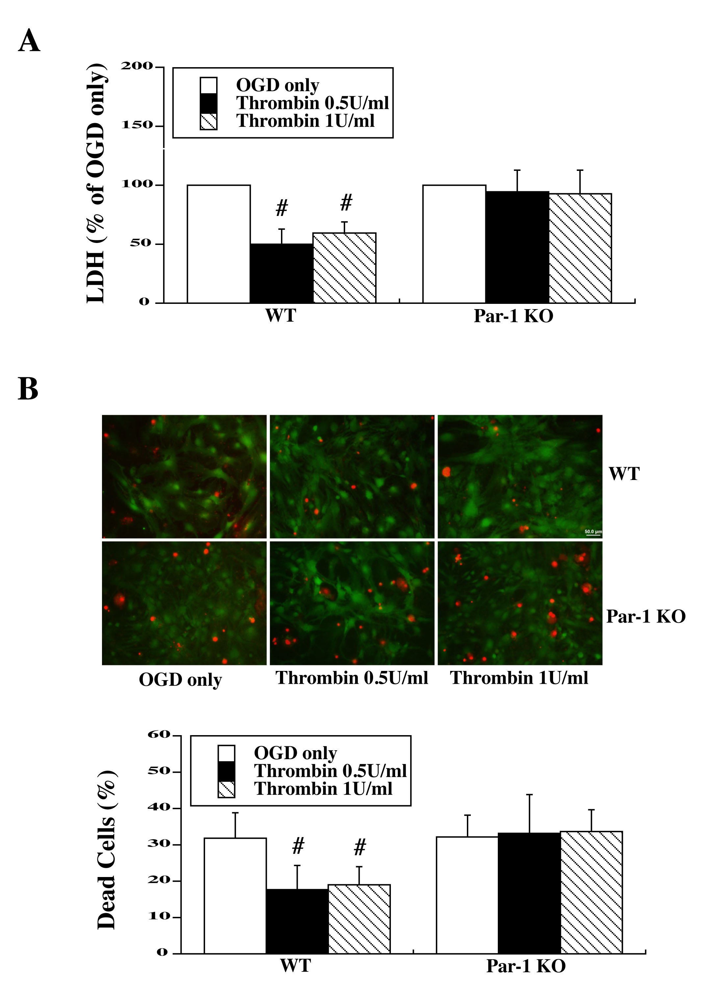
Figure 1: Primary astrocyte cultures from WT and PAR-1 KO mice were pretreated with two doses of thrombin for 24 h and then exposed to oxygen glucose deprivation (OGD) for 3 h.
Bao et al., Conditioning Medicine 2018; 1(2):57-63

