Slide 1
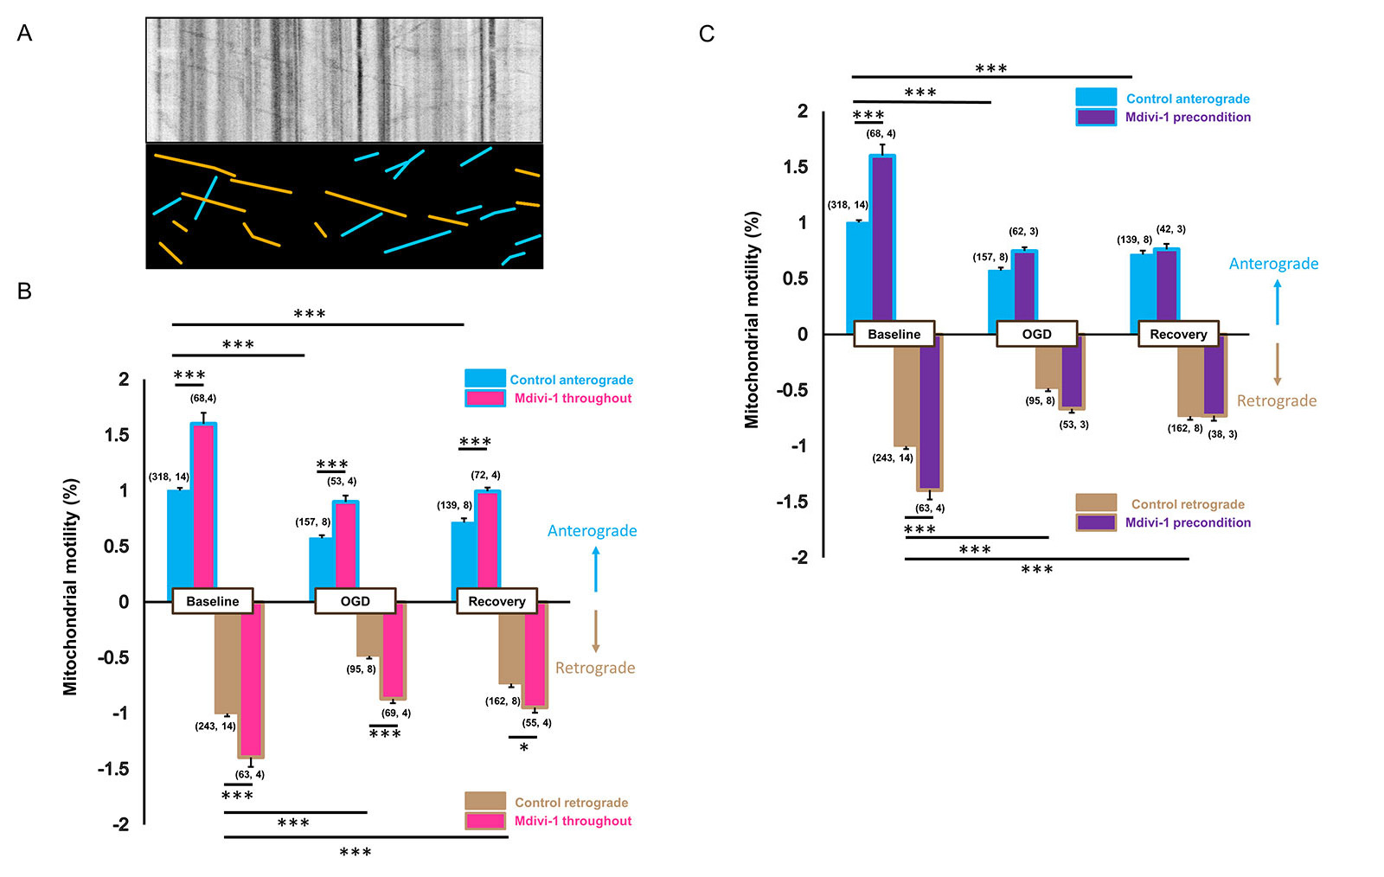
Figure 3: Mdivi-1 preserves mitochondrial motility against ischemia only when applied during OGD.
Bastian et al., Conditioning Medicine 2018; 1(2):64-72

