Slide 1
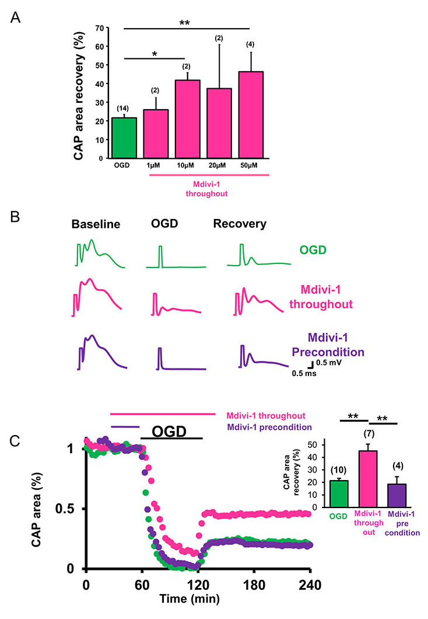
Figure 2: Inhibition of mitochondrial fission promotes WM function after ischemia.
Bastian et al., Conditioning Medicine 2018; 1(2):64-72

