Slide 1
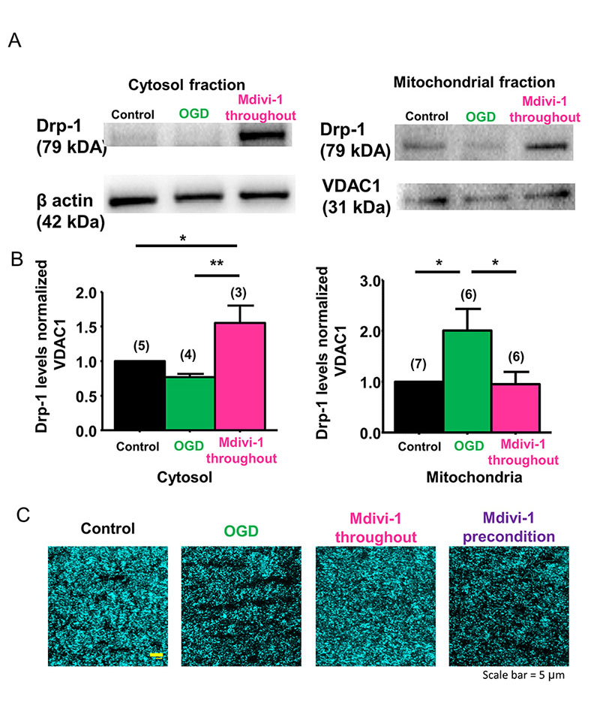
Figure 1: Drp-1 regulates ischemia-induced mitochondrial fission in WM.
Bastian et al., Conditioning Medicine 2018; 1(2):64-72

