Slide 1
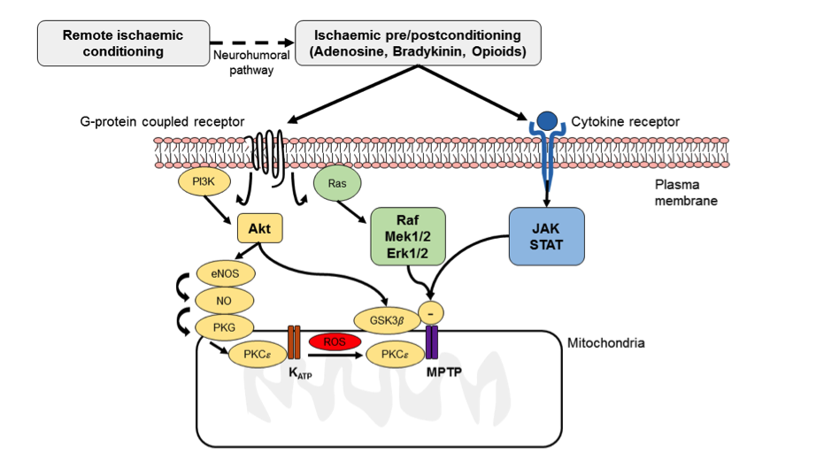
Figure 2: Major signalling pathways within the cardiomyocyte underlying ischaemic conditioning.
Mervyn Chan et al. Conditioning Medicine 2017; 1:E0001-0030

