Slide 1
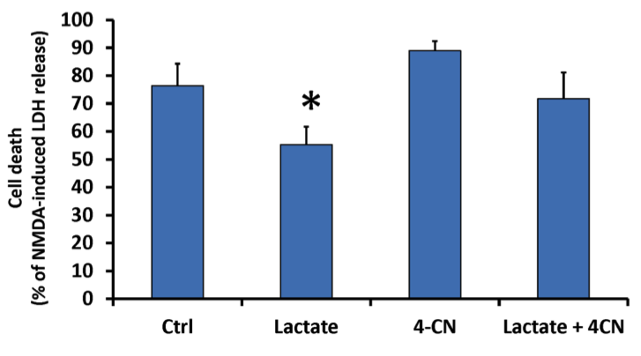
Figure 4: Exogenous lactate administration decreases neuronal cell death following lethal OGD.
Srinivasan V. Narayanan and Miguel A. Perez-Pinzon,Conditioning Medicine 2017; 1(1)

