Slide 1
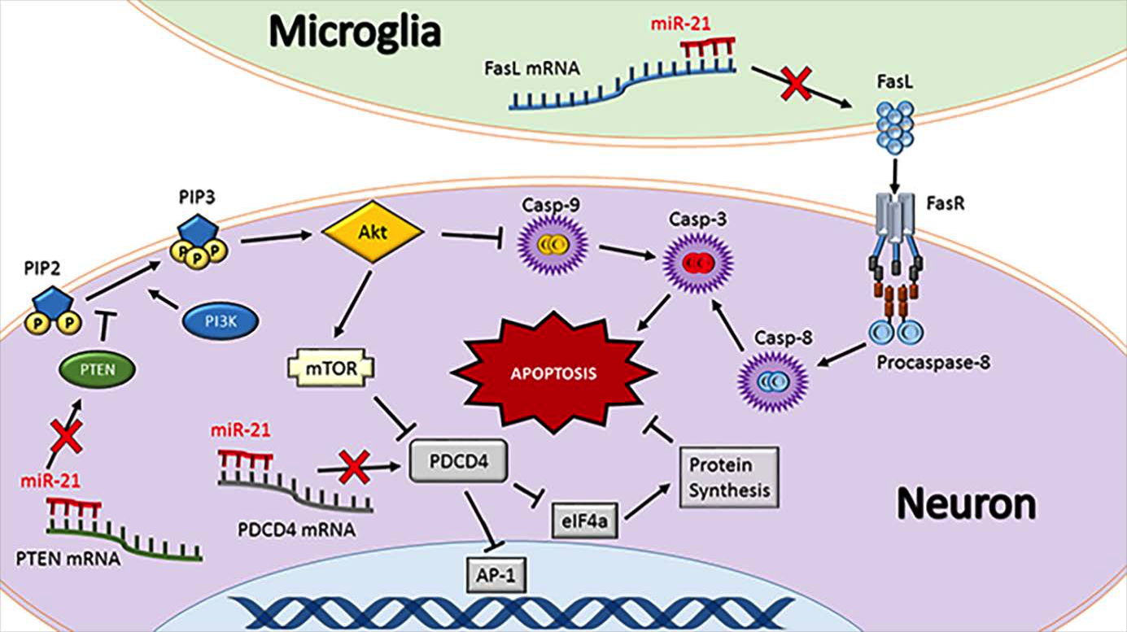
Figure 1: miR-21 regulates apoptosis.
Mary S. Lopez et al,Conditioning Medicine 2017; 1(1)

