Slide 1
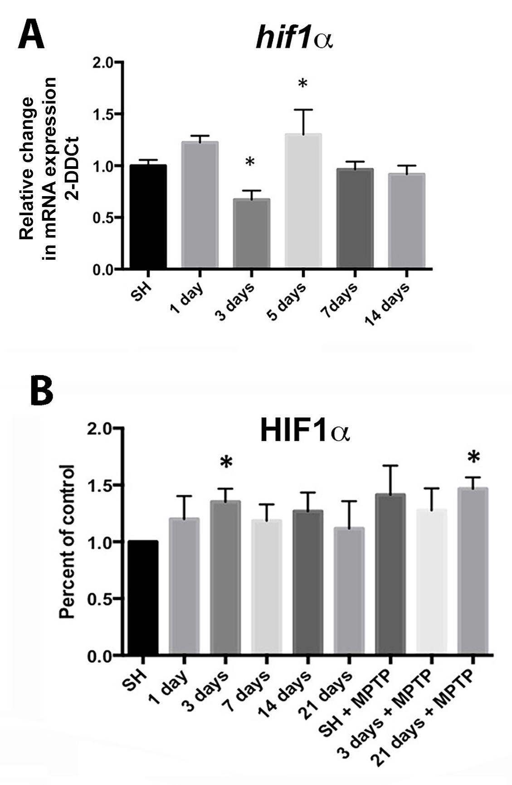
Figure 4. Expression of hypoxia sensitive molecules in the SN is modulated by wheel running exercise.
Michelle Smeyne et al., Conditioning Medicine 2019; 2(3):142-154.

