Slide 1
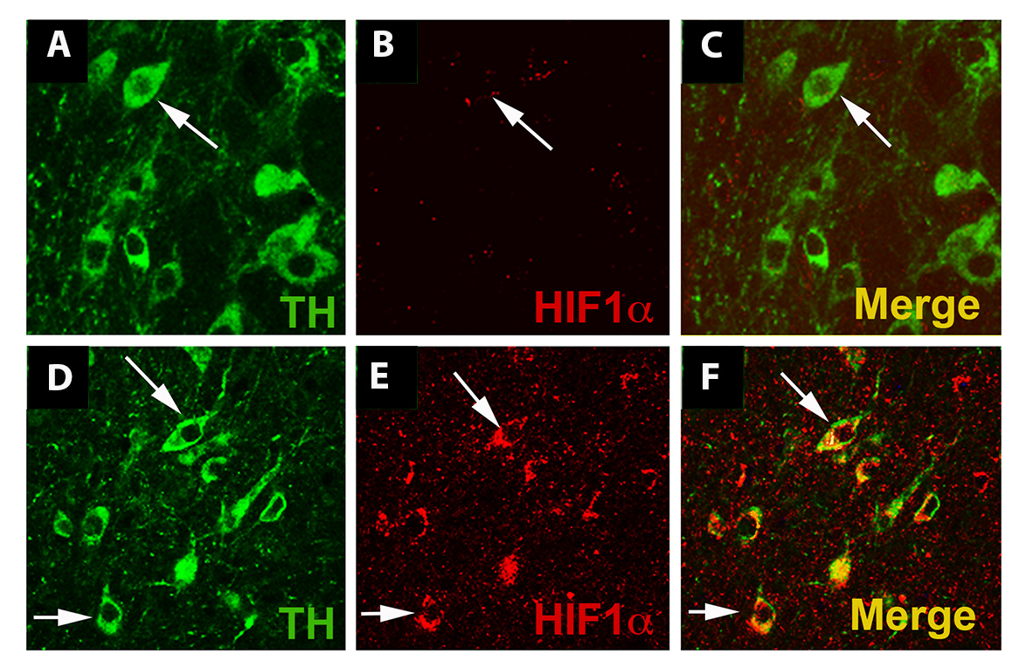
Figure 3. Exercise enhances HIF1α immunostaining in dopaminergic cells.
Michelle Smeyne et al., Conditioning Medicine 2019; 2(3):142-154.

