Slide 1
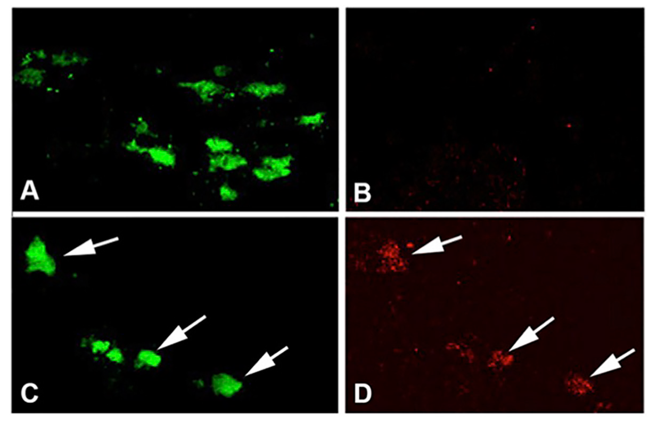
Figure 2. Exercise induces hypoxia in SNpc DA neurons.
Michelle Smeyne et al., Conditioning Medicine 2019; 2(3):142-154.

