Slide 1
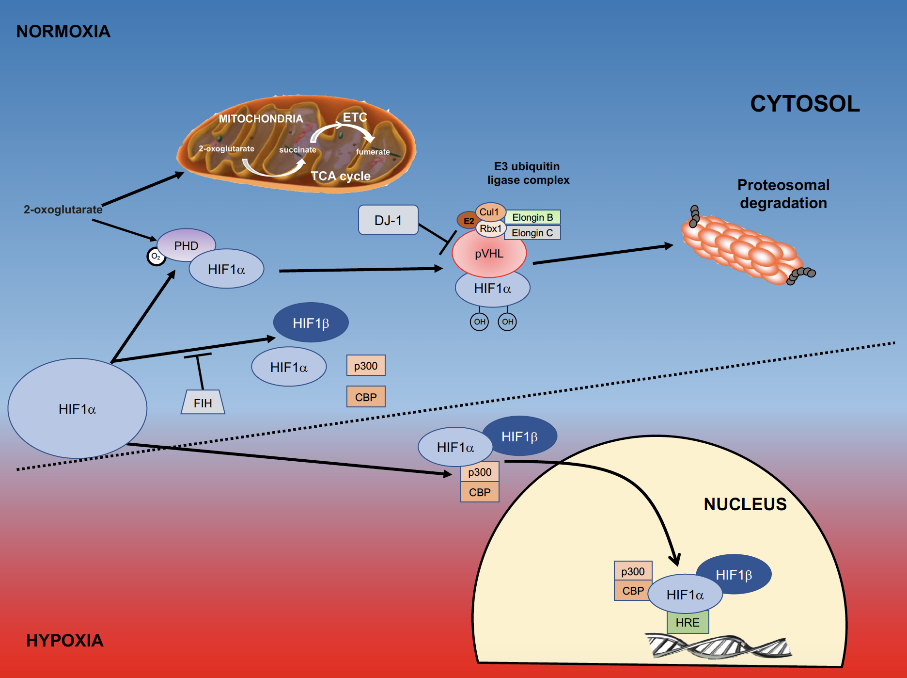
Figure 1. Role of HIFα in hypoxia.
Michelle Smeyne et al., Conditioning Medicine 2019; 2(3):142-154.

