Slide 1
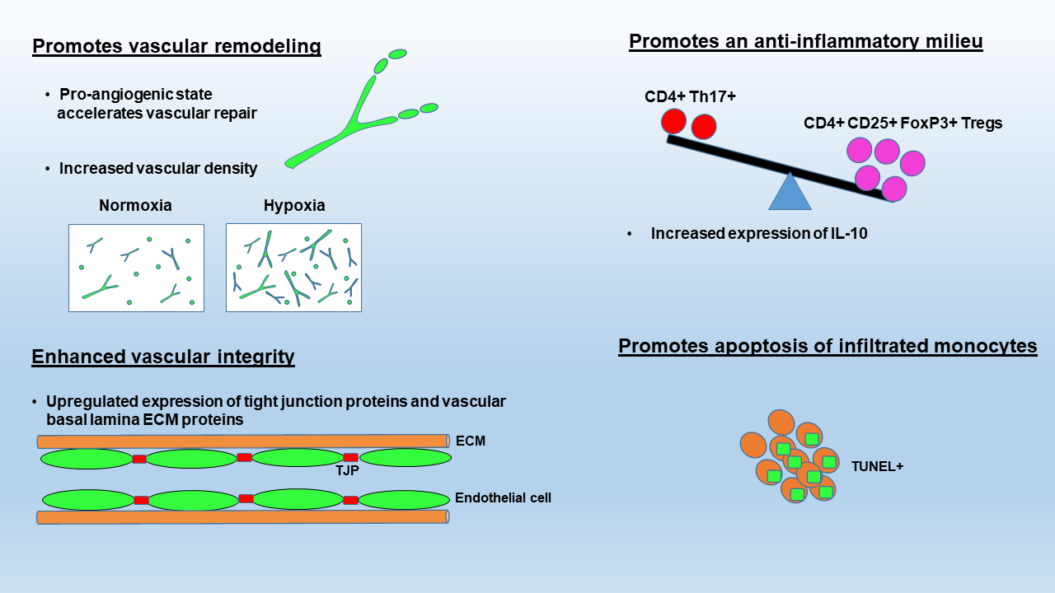
Figure 1. Summary of the proposed molecular mechanisms underlying the protective influence of hypoxic conditioning in MS.
Halder and Milner, Conditioning Medicine 2021; 4(1):3-14.

