Slide 1
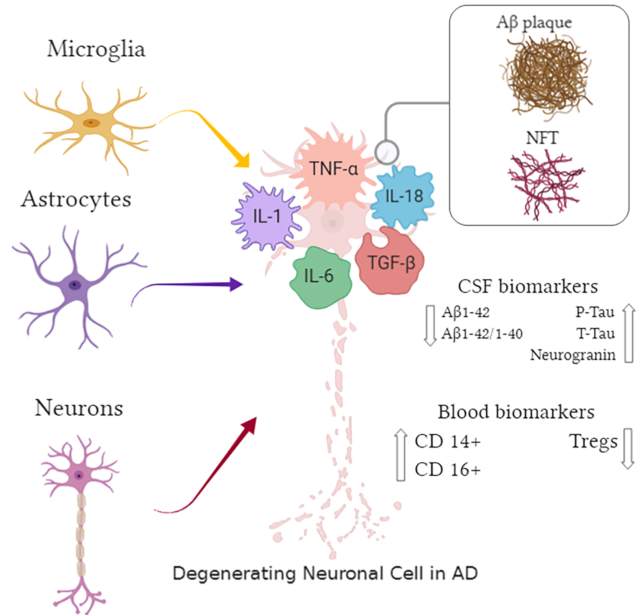
Figure 1. Pathological hallmarks and biomarkers in Alzheimer's disease (AD): an overview. Arrows represent activation of cellular mediators; IL-1: interleukin -1; IL-6: interleukin-6; IL-18: interleukin-18; TNF-α: tumor necrosis factor alpha; TGF-β: transforming growth factor beta; Aβ: amyloid beta; P-tau: phosphorylated tau; T-tau: total tau; NFT: neurofibrillary tangles: Tregs: T-regulatory cells.
Girishkumar Sivakumar et al., Conditioning Medicine 2020; 3(6):xxx-xxx.

