Slide 1
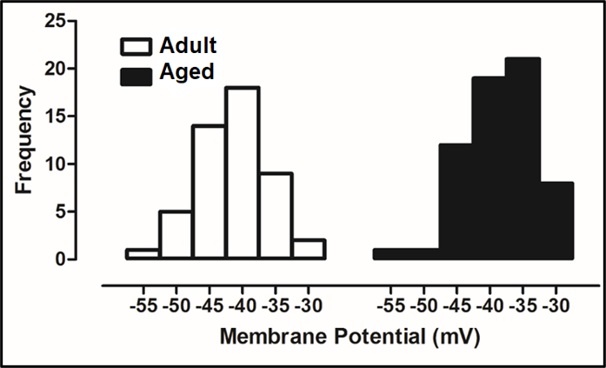
Figure 1.
Turan, Conditioning Medicine 2022; 5(2):51-58.

