Slide 1
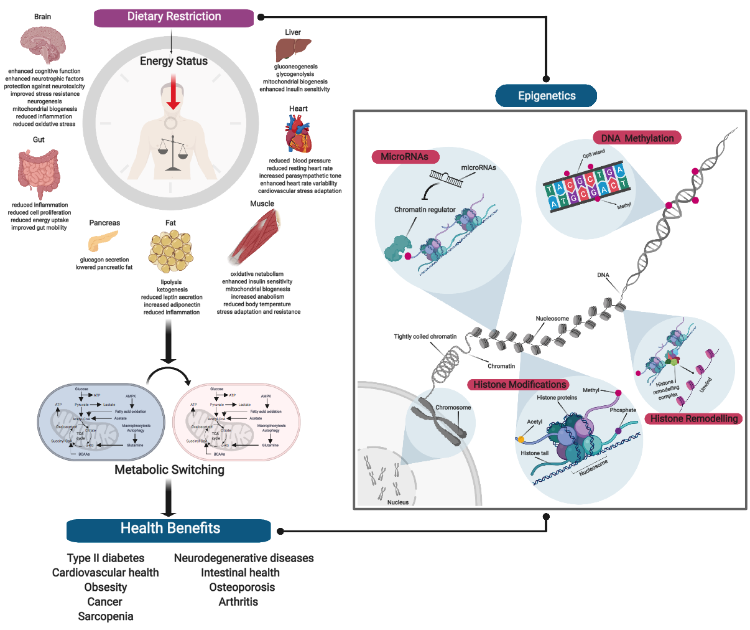
Figure 1. Dietary Restriction and Epigenetics.
Gavin Yong-Quan Ng et al., Conditioning Medicine 2019; 2(6):300-310.

