Slide 1
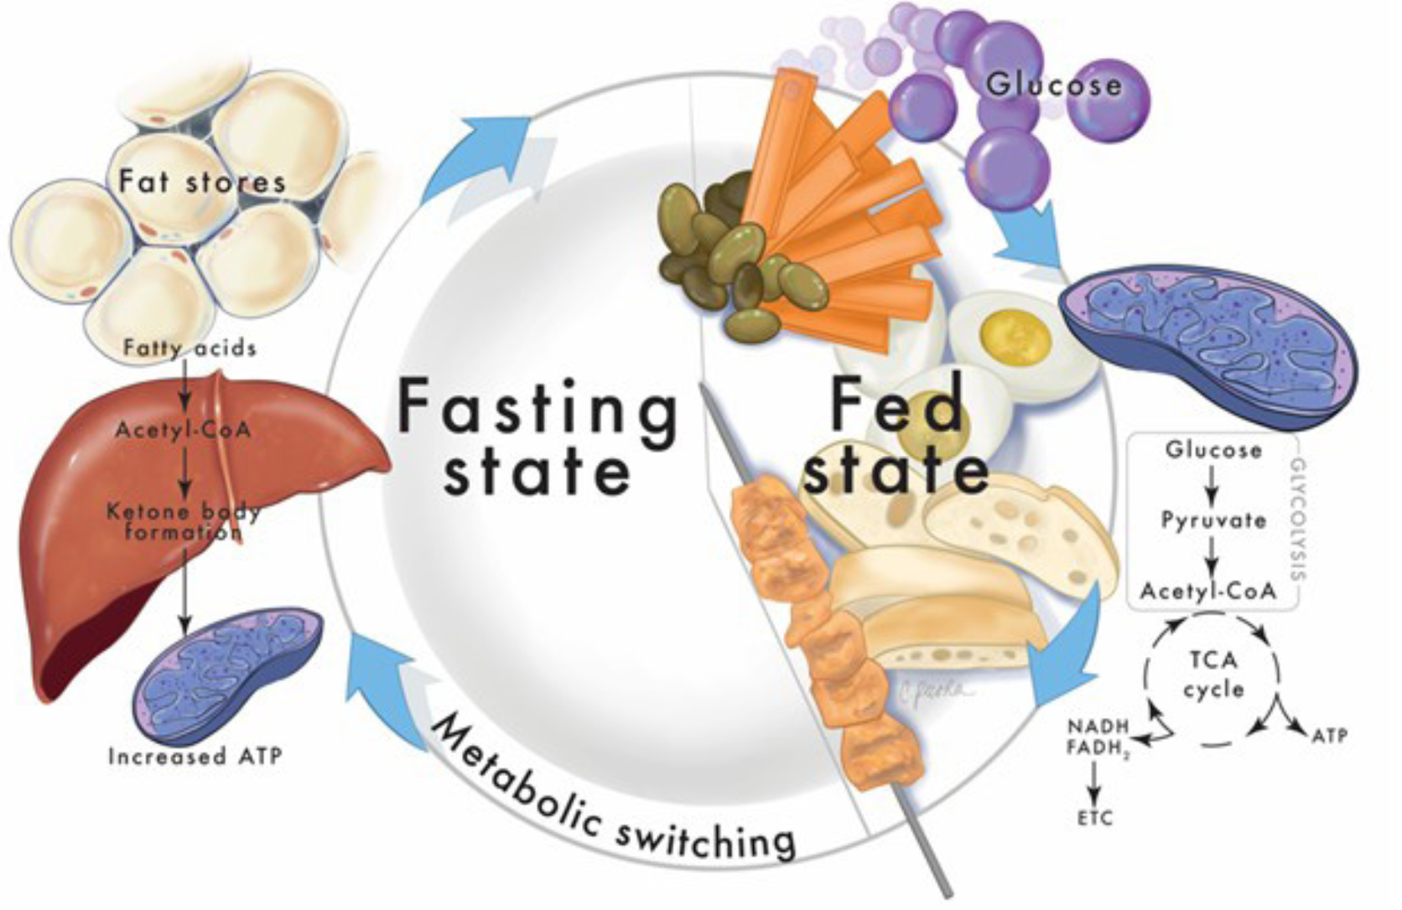
Figure 2.
Epstein et al.; Conditioning Medicine 2024; 7(2): 48-61.

