Slide 1
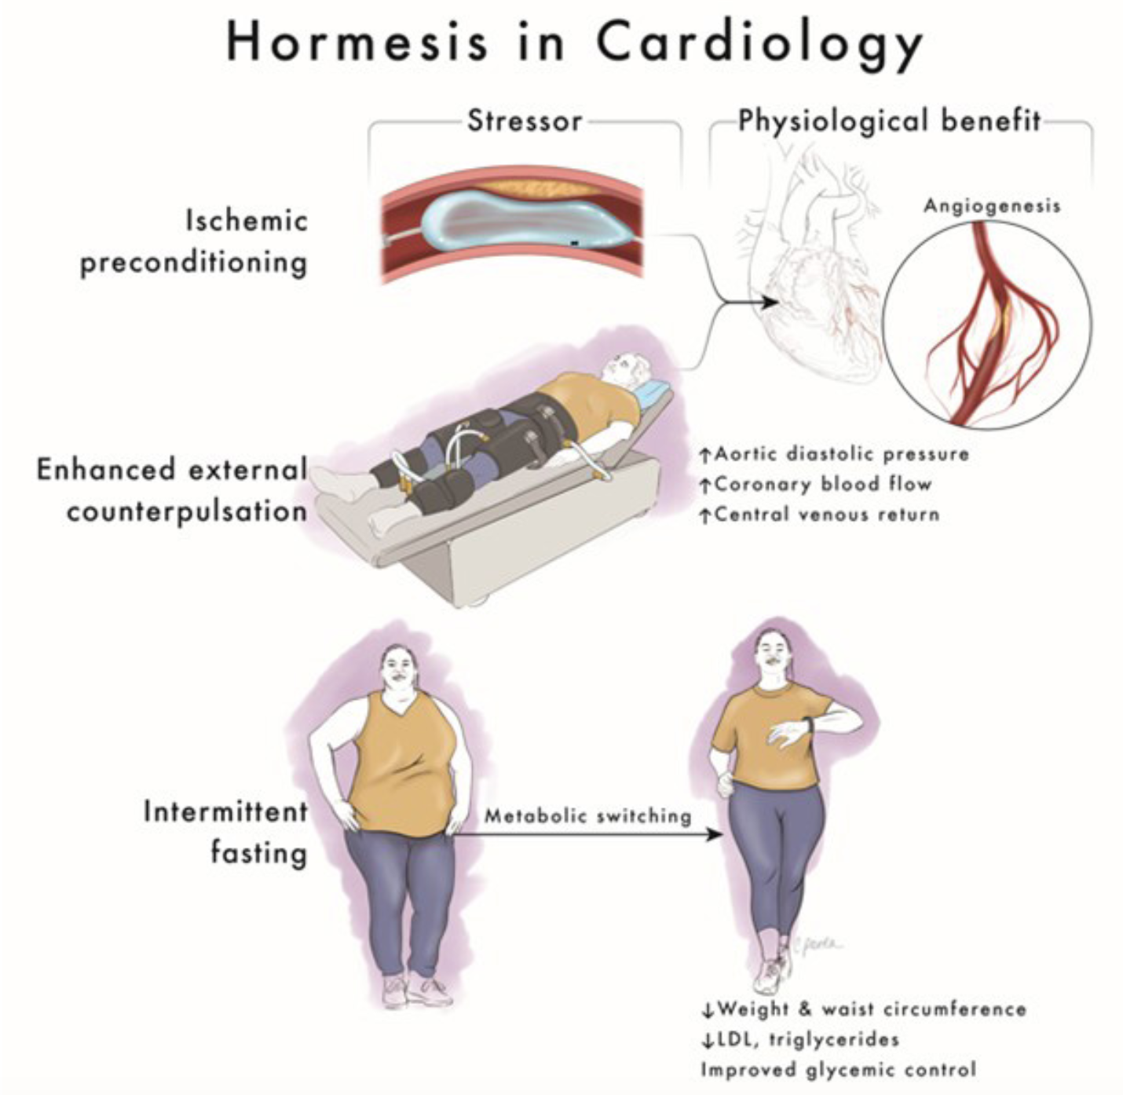
Figure 1.
Epstein et al.; Conditioning Medicine 2024; 7(2): 48-61.

