Slide 1
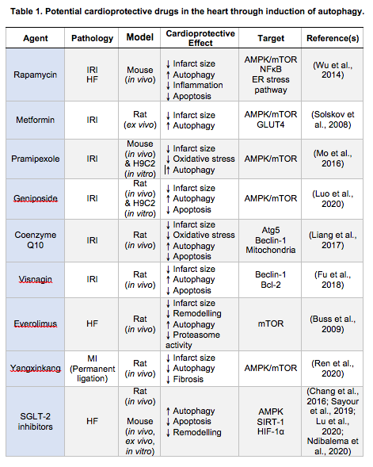
Jasper Chua et al., Conditioning Medicine 2020; 3(6):xxx-xxx.

