Slide 1
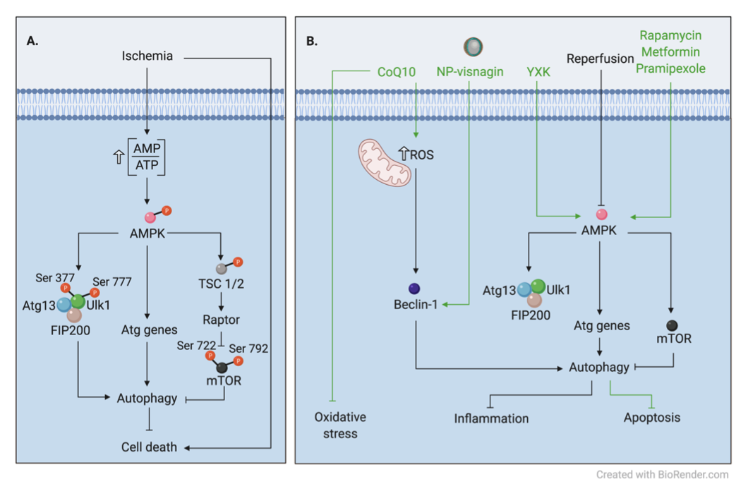
Figure 1. Signaling regulation of autophagy during acute myocardial IRI and potential cardioprotective therapies. (A) Ischemia increases the AMP/ATP ratio and activates AMPK. AMPK has a dual action to promote autophagy via inhibition of mTOR and activation of Ulk1 via phosphorylation at Ser 377 and Ser 777. AMPK indirectly inhibits mTOR via its phosphorylation at Ser 722 and Ser 792. (B) In contrast, during reperfusion, activation of AMPK is no longer observed. Instead, autophagosome formation during reperfusion is mediated by Beclin-1-dependent mechanisms.
Jasper Chua et al., Conditioning Medicine 2020; 3(6):xxx-xxx.

