Slide 1
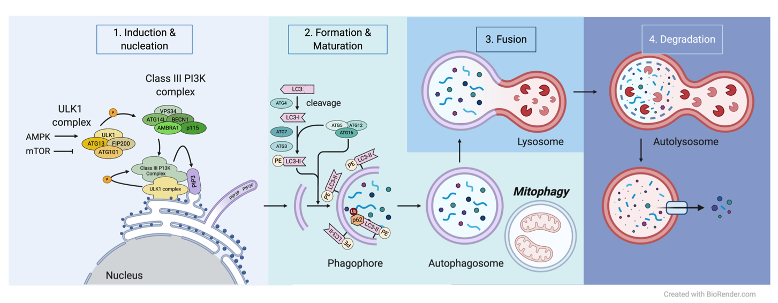
Figure 1. Schematic diagram of phases of autophagy in cardiomyocytes. (1) Induction and nucleation, (2) formation and maturation, (3) fusion, and (4) degradation. Autophagy-activating kinase 1, ULK1; protein of 200kDa, FIP200; autophagy-related protein, Atg; endoplasmic reticular, ER; phosphatidylethanolamine, PE; phosphatidylinositol 3-phosphate, PIP3; 1 light chain 3, LC3; adenosine monophosphate, AMP; adenosine triphosphate, ATP; mammalian target of rapamycin, mTOR.
Jasper Chua et al., Conditioning Medicine 2020; 3(6):xxx-xxx.

