Slide 1
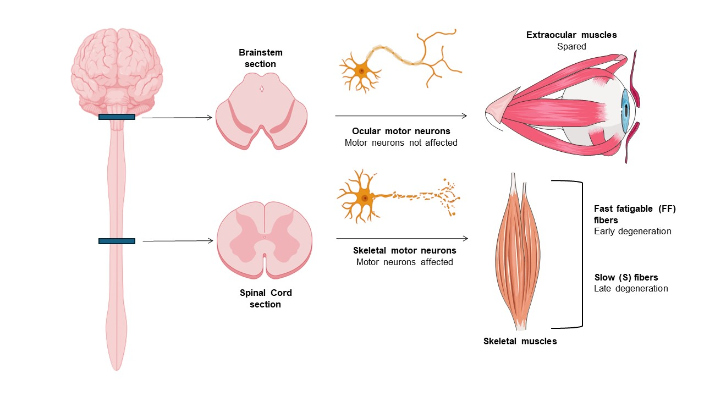
Figure 1.
Kolici et al.; Conditioning Medicine 2024; 7(1): 22-25.

