Slide 1
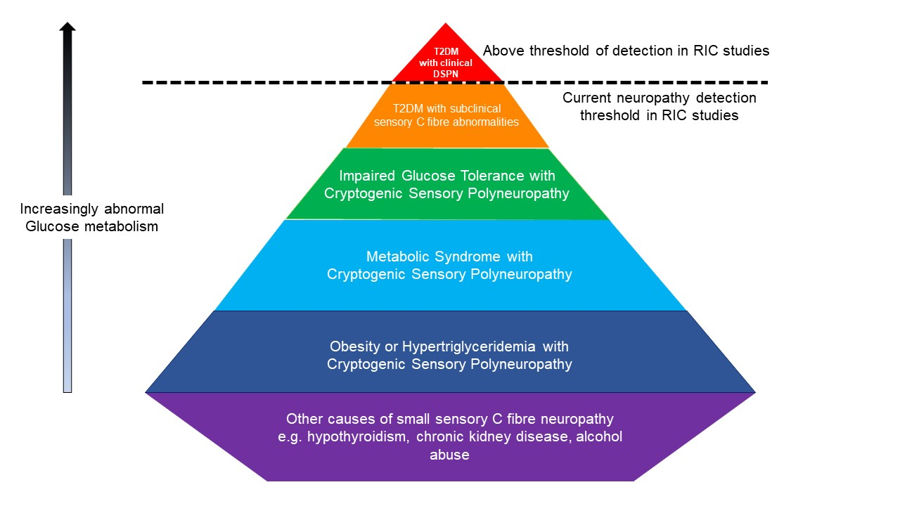
Figure 1. This pyramid highlights the groups of participants at risk of sensory C fiber abnormalities that may be undetected in RIC studies.
Epps et al, Conditioning Medicine 2022; 5(1):11-21.

